Slide 1


Product selection
AST series | MGC series | AMZ series | AMT series
Shenzhen Jinxi Intelligent Control Technology Co., Ltd | Huizhou Jinxi Intelligent Control Technology Co., Ltd

Slide 2
directory
03
04
05
About us
Corporate glory
AST series
10
14
29
MGC series
AMZ series
AMT series

Slide 3

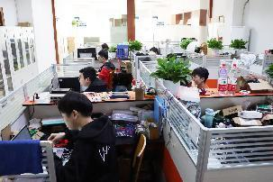
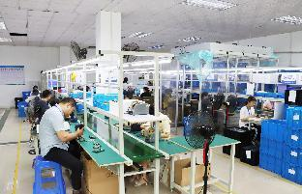
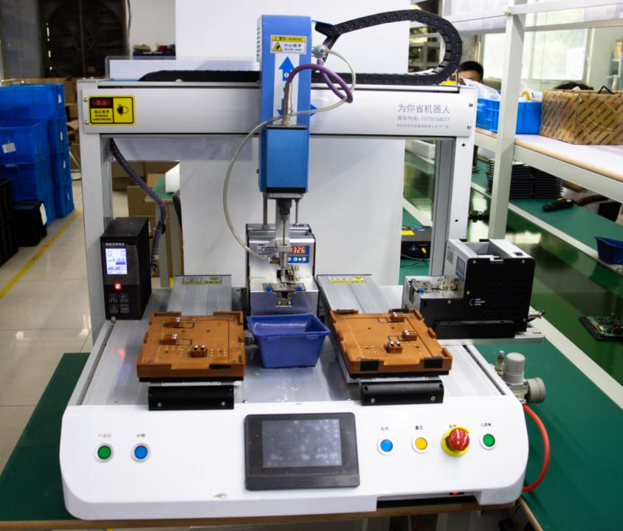
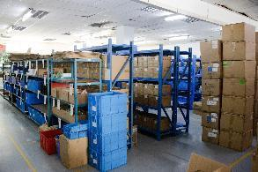
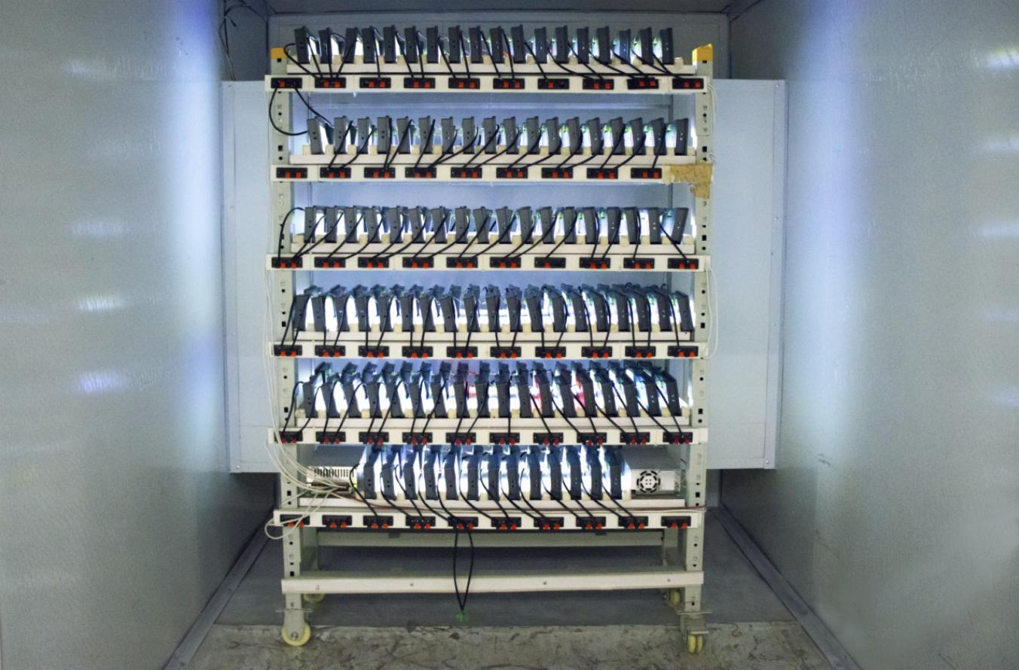
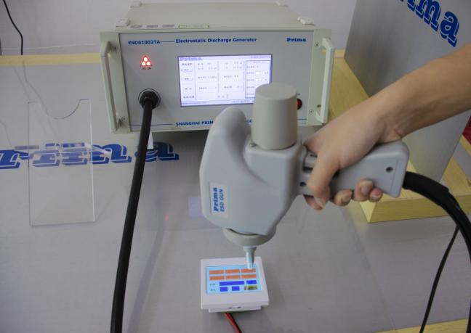
About us
Shenzhen Kinseal Intelligent Control Technology Co., Ltd. is a technology-driven enterprise specializing in the development, production, and sales of industrial serial screens, human-machine interfaces (HMIs), and display terminals. Established with a commitment to market-oriented innovation, we strive to deliver a wide range of HMI products, solutions, and services tailored to meet diverse customer needs. Our products have been widely adopted in numerous fields, including industrial automation equipment, medical devices, transportation, instrumentation, HVAC systems, air purification, and consumer electronics.
Over the years, Kinseal has made significant strides in technology and market development. We have accumulated a robust portfolio of intellectual property, which includes 8 software copyrights, 10 utility model patents, and 6 invention patents (with 3 granted, 2 under substantive examination, and 1 under review). These achievements underscore our dedication to innovation and quality.
In recognition of our technological advancements and market impact, Kinseal was designated as a National High-Tech Enterprise in 2018 and successfully passed the high-tech enterprise re-evaluation in 2021. We have also attained ISO9001 quality management system certification in 2021, ensuring our commitment to quality standards, and ISO14000 environmental management system certification in 2022, reflecting our dedication to sustainable practices. In 2023, our innovative capabilities were further acknowledged when we were named an Innovative Enterprise and a Specialized and New Enterprise.
Our mission at Kinseal is to harness the power of technology to create value for our customers and make meaningful contributions to society. We are unwavering in our pursuit of excellence in smart display terminal development, continuously enhancing product quality and service levels to meet and exceed industry standards. Our customer-centric approach drives us to innovate and deliver solutions that not only meet the current。

Slide 4
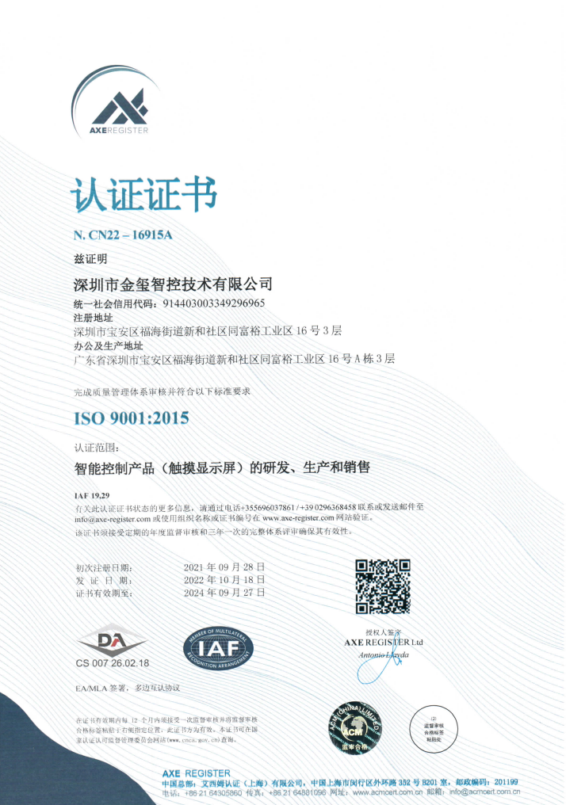
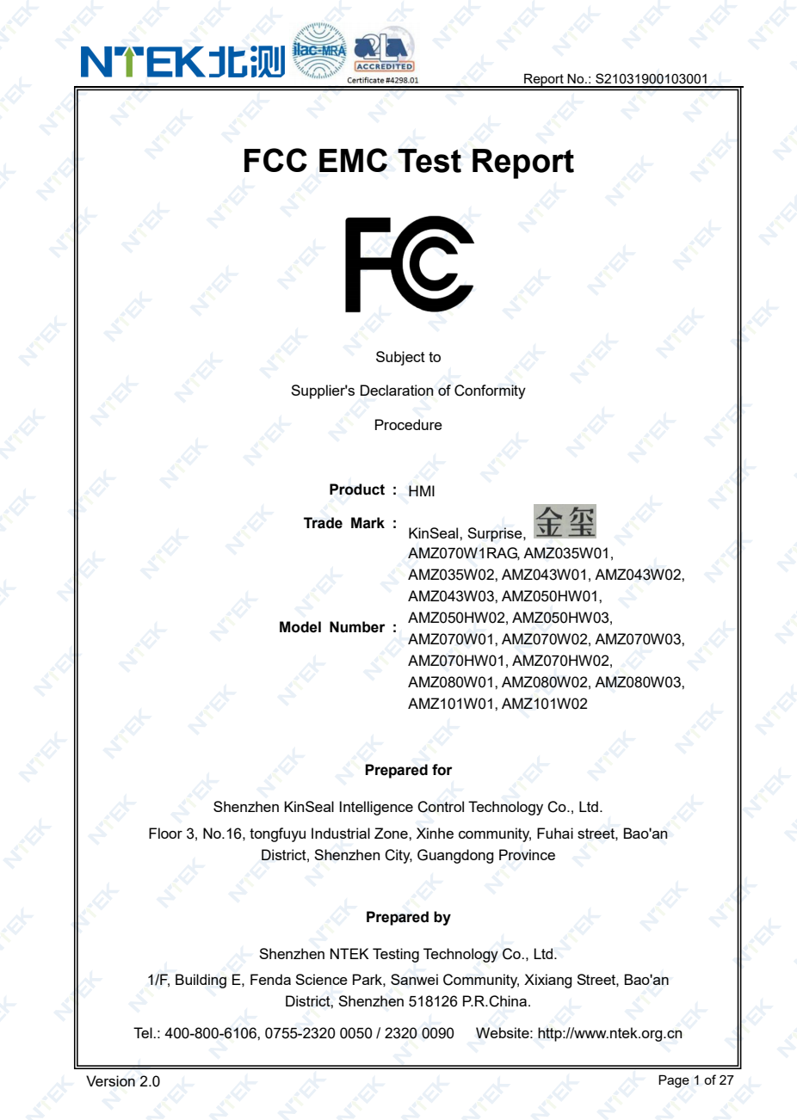
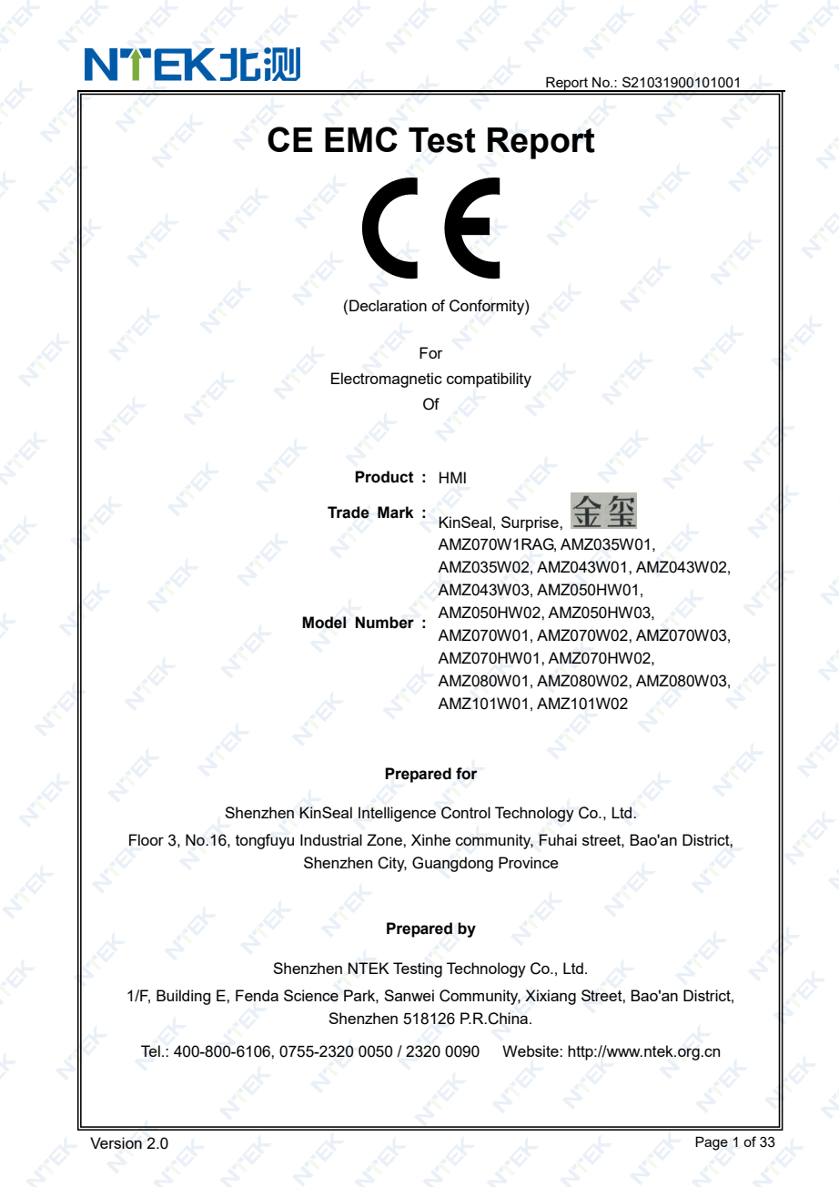

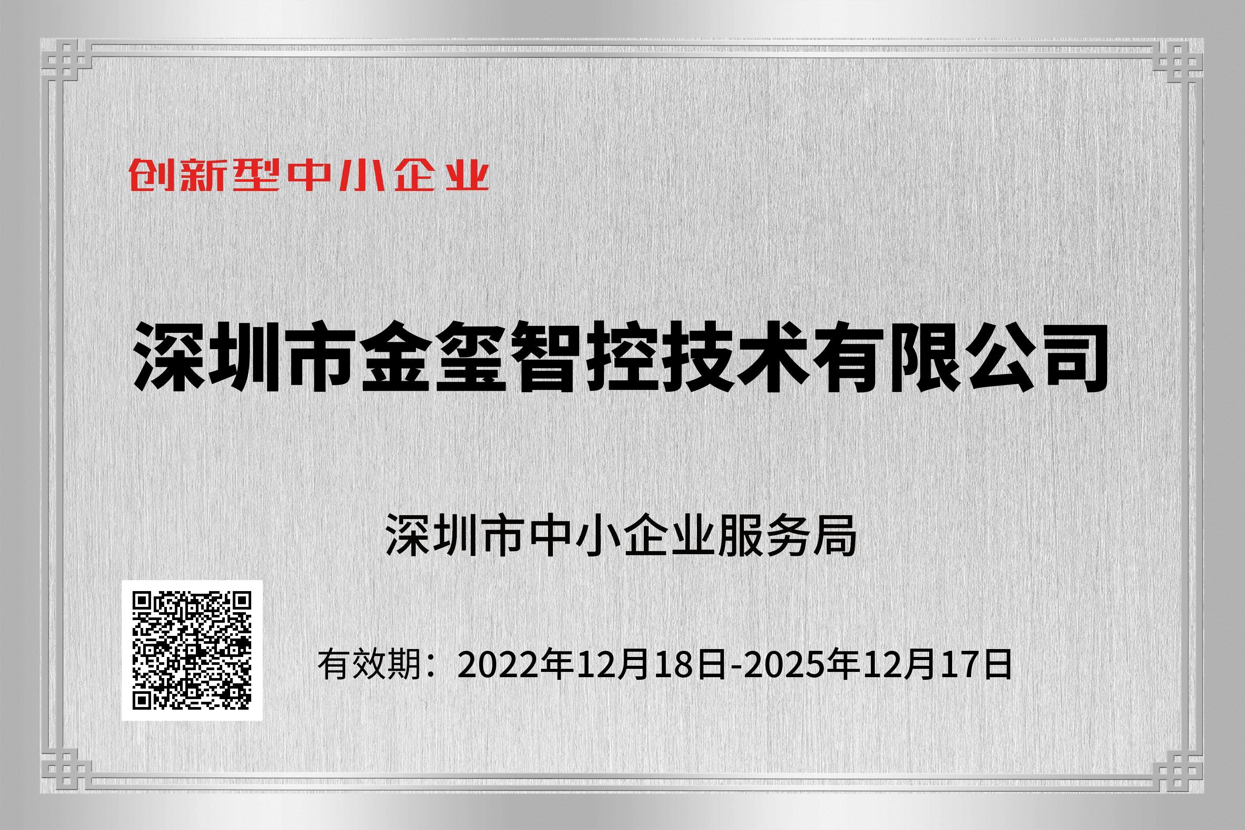
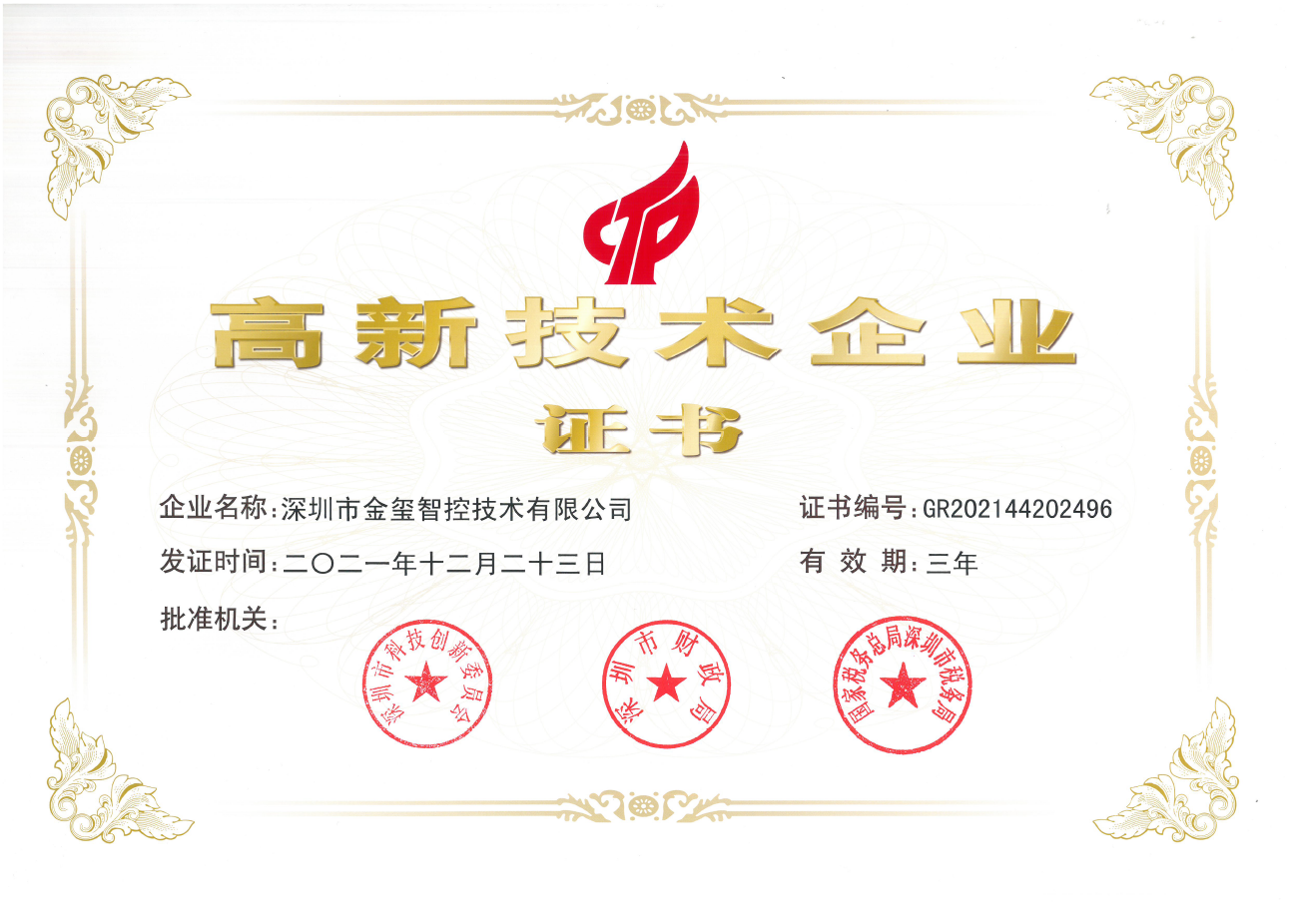
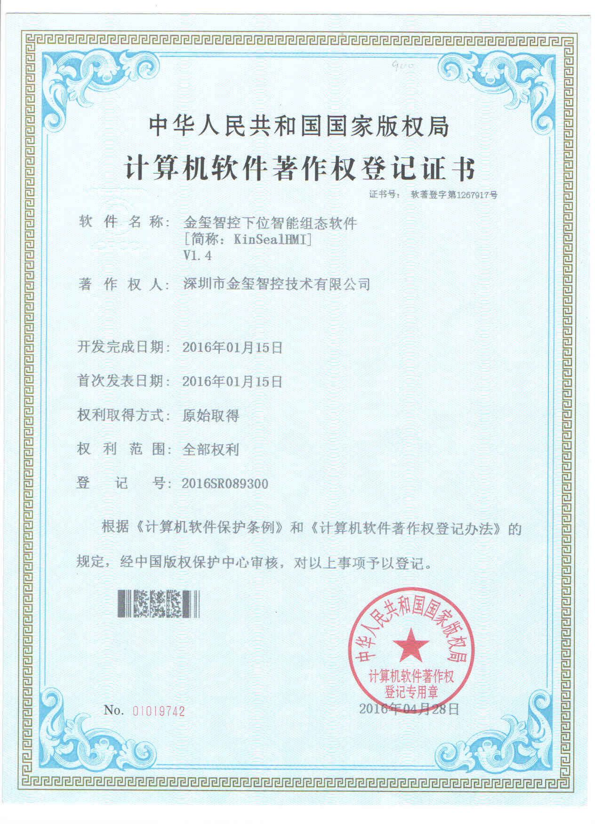
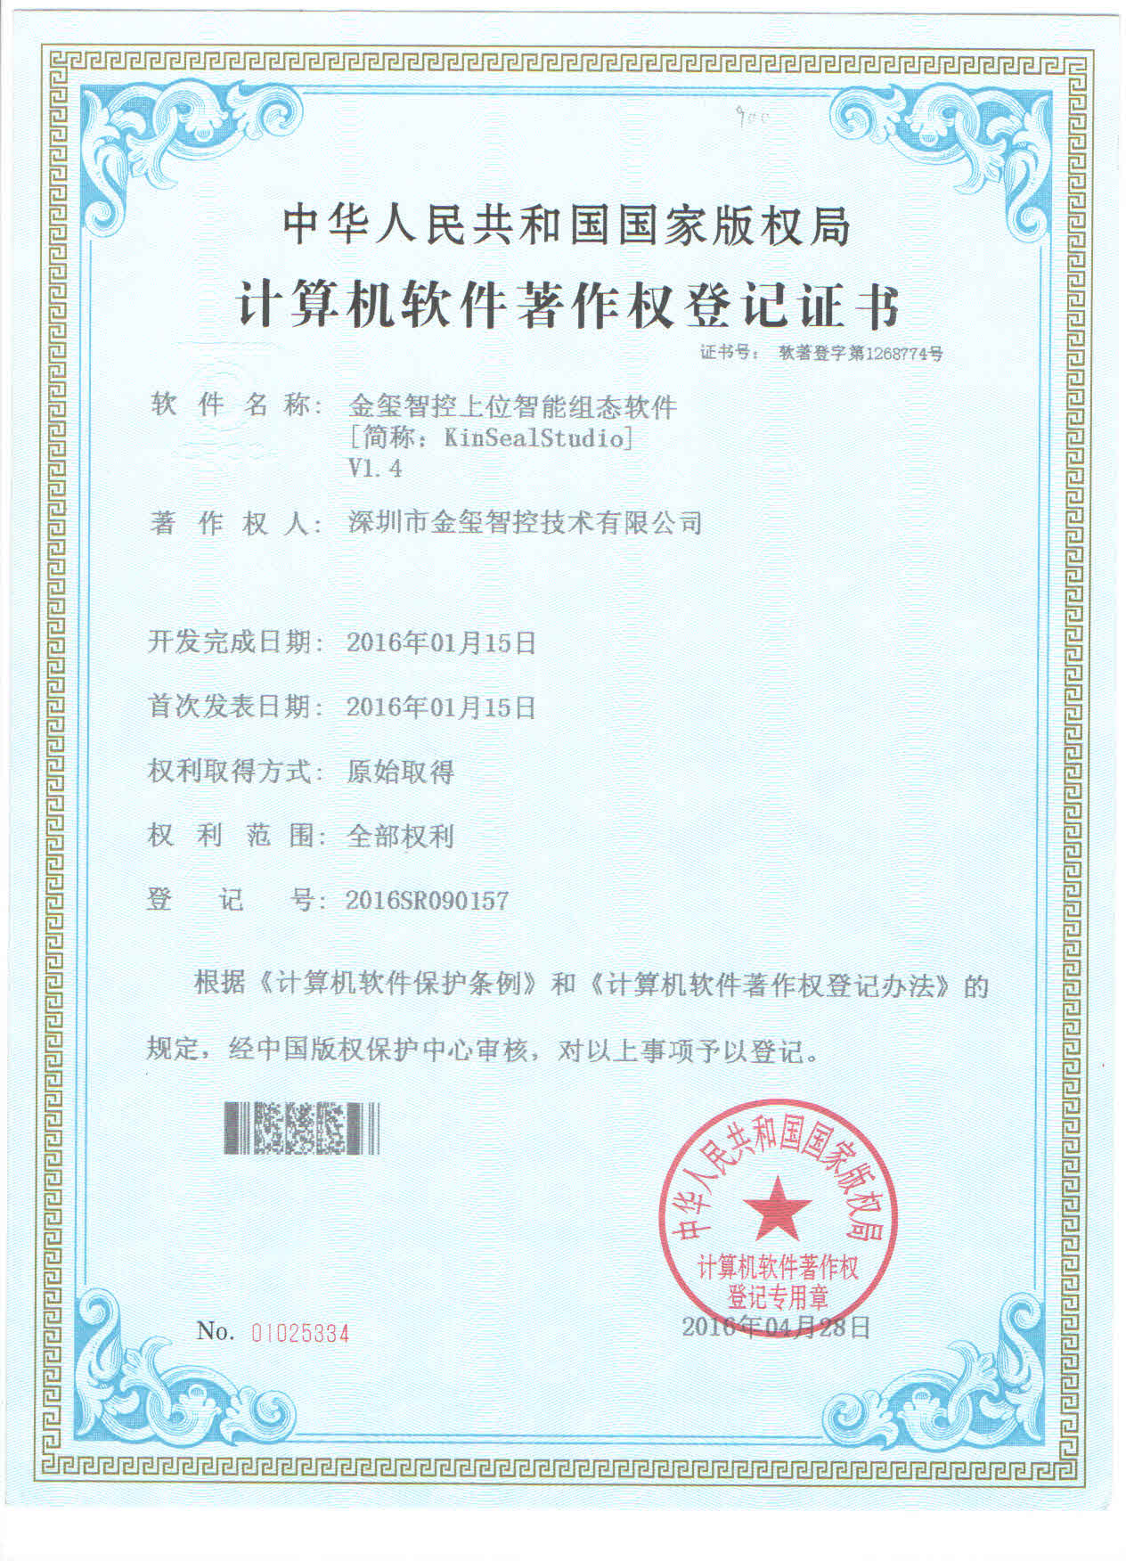
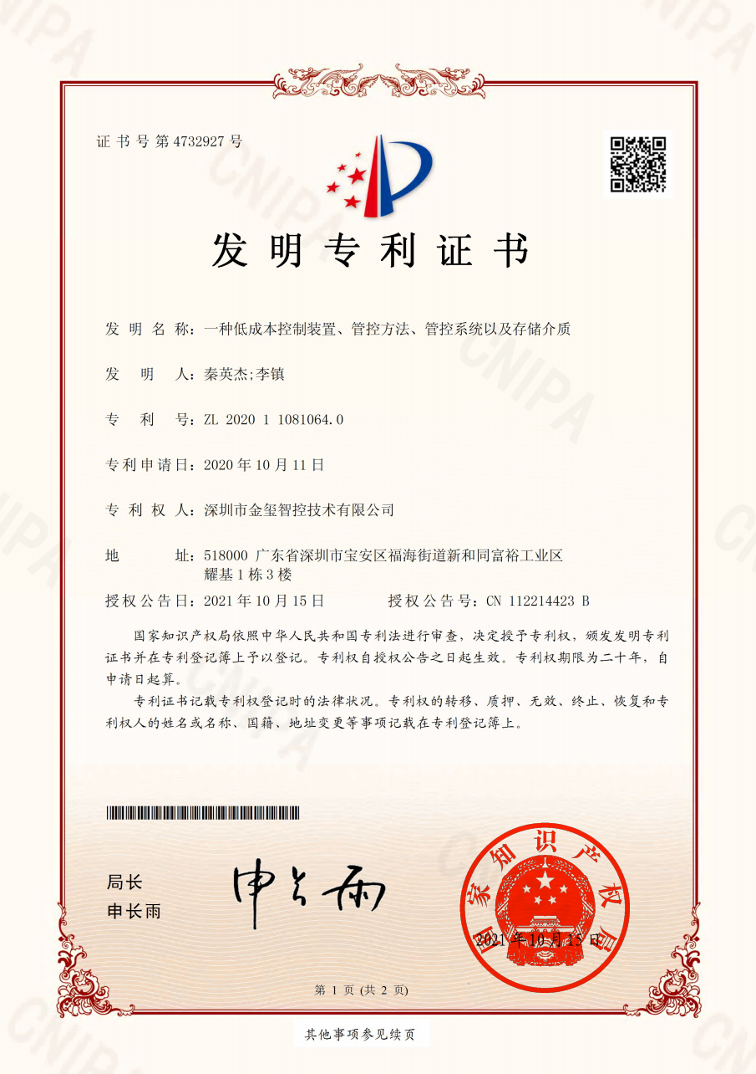
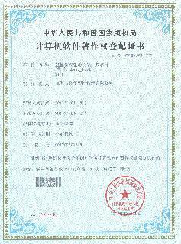
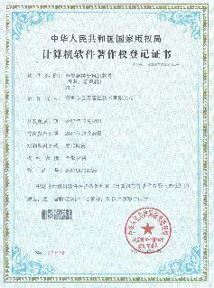
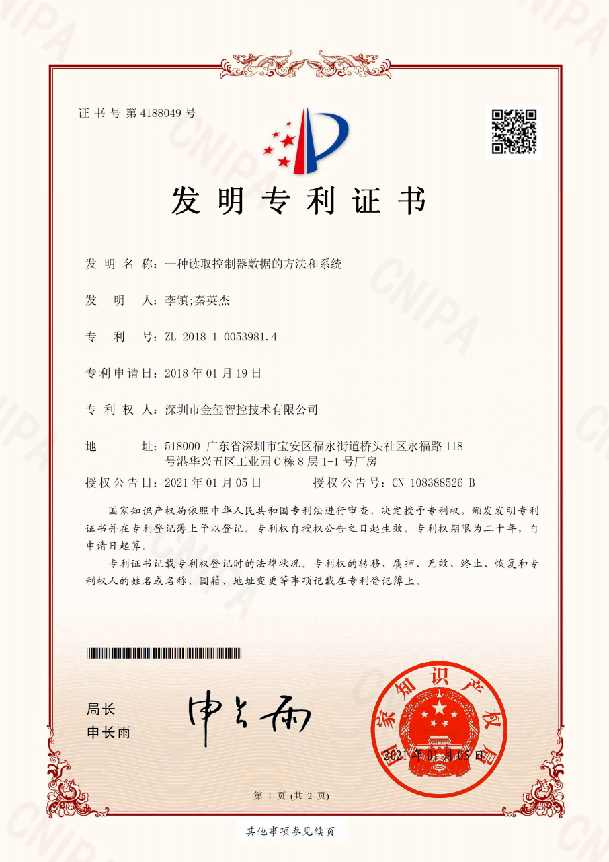
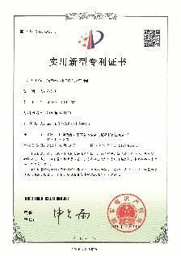
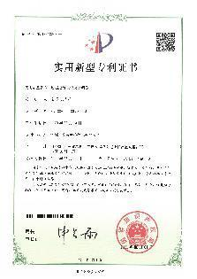
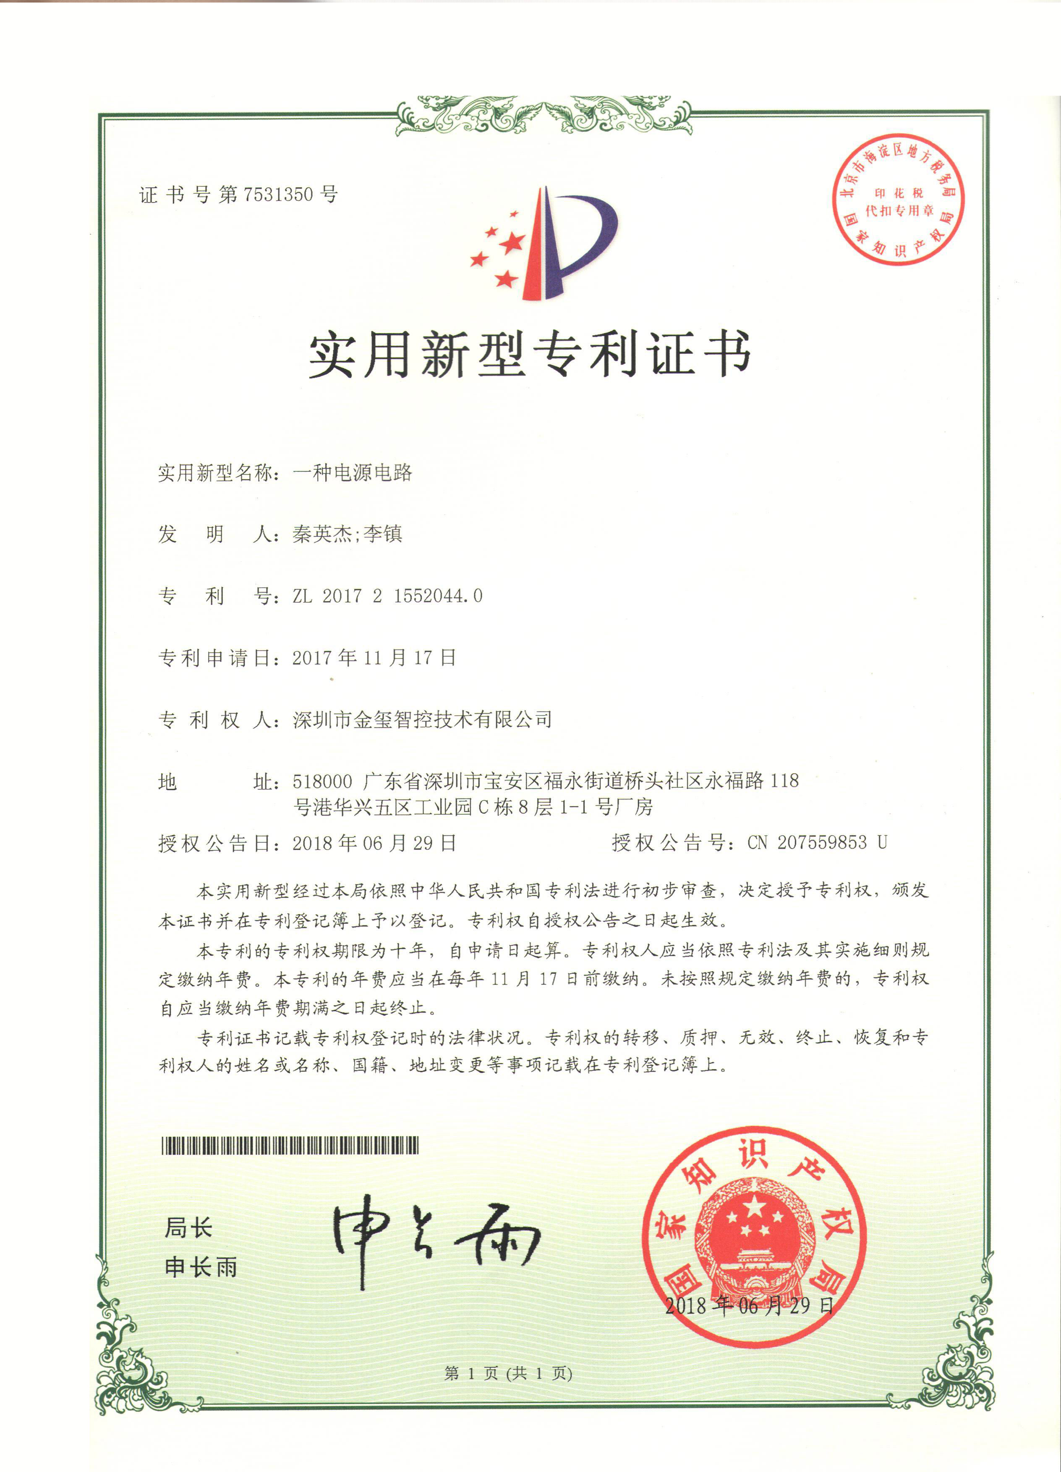
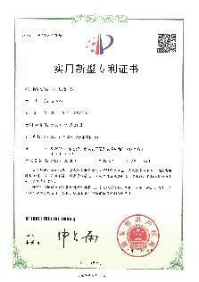
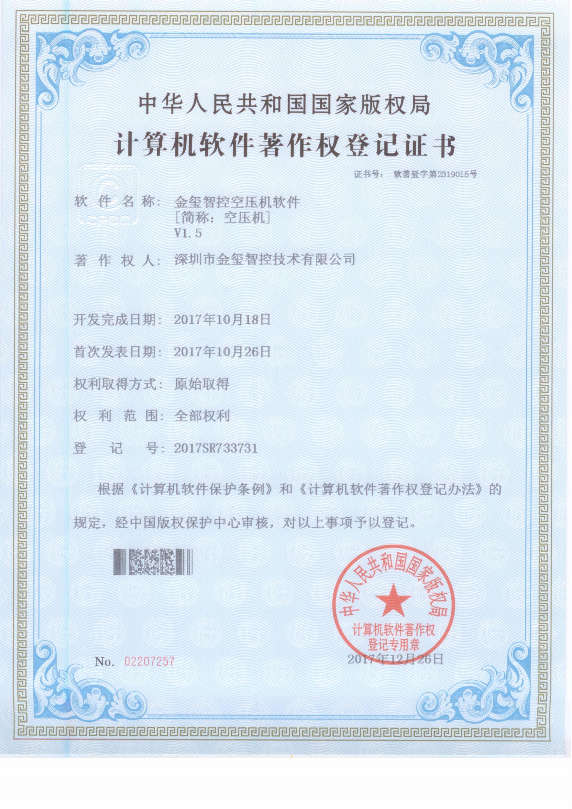
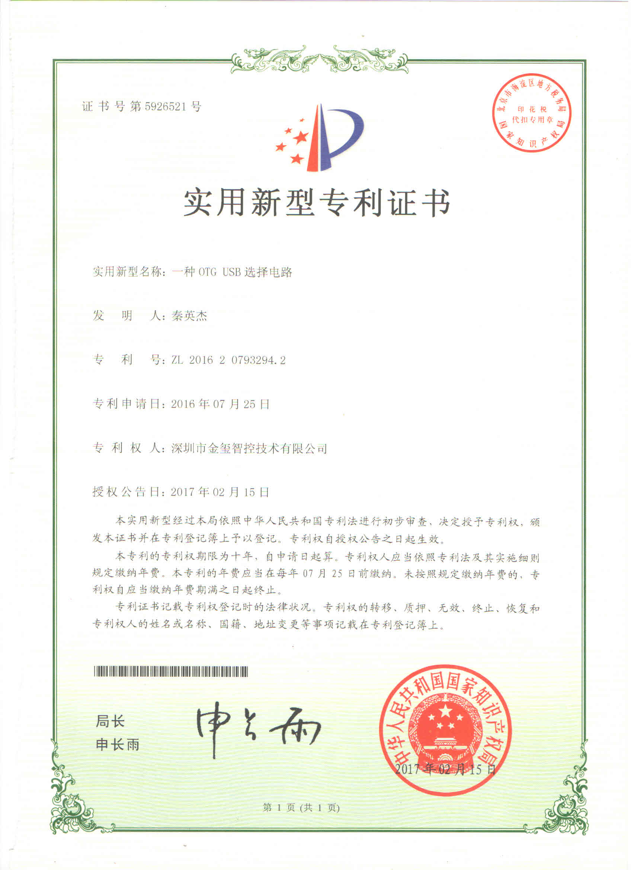
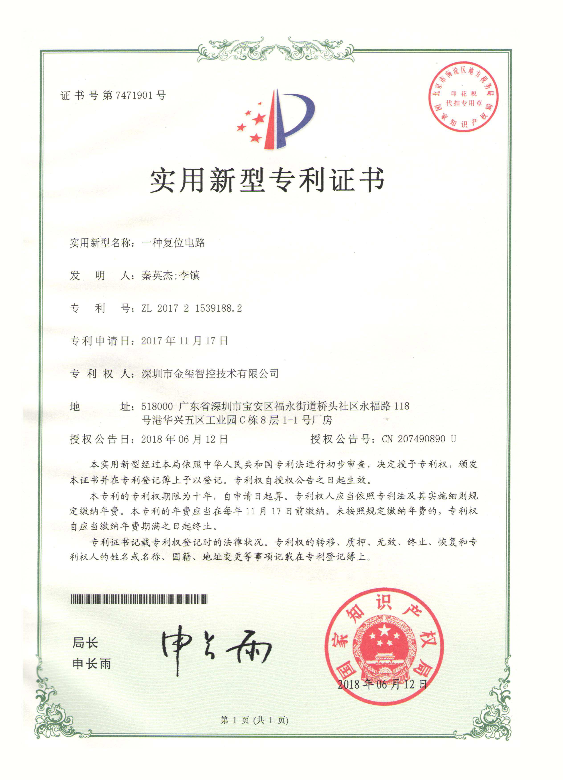
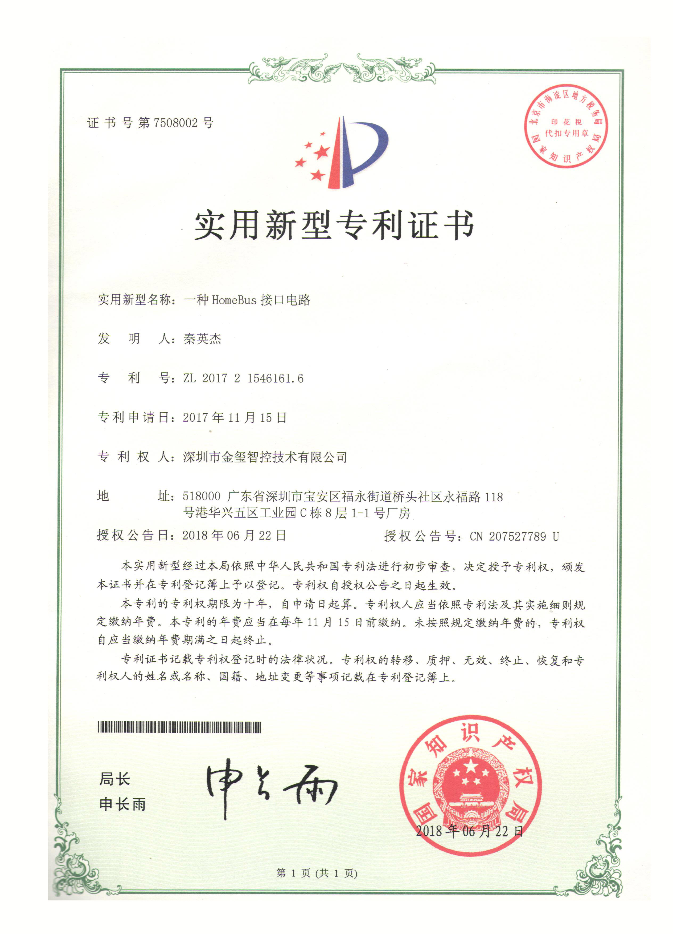
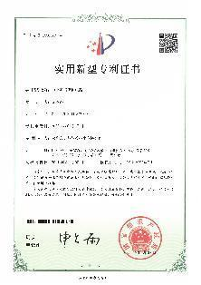
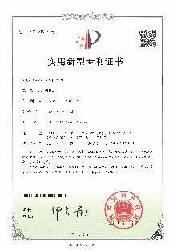
Corporate glory

Slide 5

AST series

Slide 6
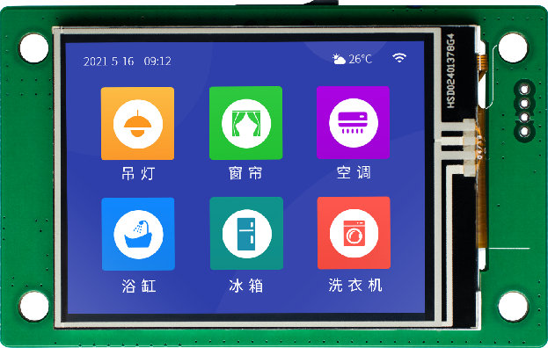
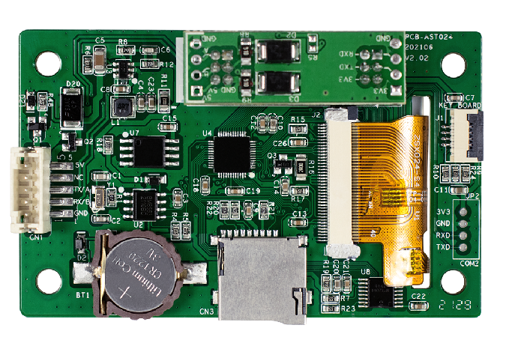
AST024 / AST028series
Model | AST024RTS/AST024RES/AST024RDS | ASTK028NGD/ASTK028RGD
display screen | 2.4" TFT LCD | 2.8" TFT LCD
color | 65535 colors | 65535 colors
Resolution (Px) | 320*240 | 320*240
brightness | 250 cd/m² | 250 cd/m²
Backlight | LED | LED
LED lifespan | 20,000 hours | 20,000 hours
touch screen | 4-wire industrial resistive touch screen (surface hardness 4H) | ASTK028RGD Support 4-wire industrial resistive touch screen (surface hardness 4H)
CPU | 96MHz M0 | 96MHz M0
memorizer | 16Mbyte SPI NOR Flash | 16Mbyte SPI NOR Flash
RTC | Real-time clock built-in | Real-time clock built-in
buzzer | not | Yes
Power-down data is saved | Not supported | Not supported
USB port | not | not
How to download the program | SD card download | SD card download
flash drive | Not supported | Not supported
Communication port | AST024RTS: TTL serial communication AST024RES: One RS232 serial communication AST024RDS: One RS485 serial communication | RS485 serial communication
Rated power | 0.5W | 1.5W
Voltage range | DC 5-24V (Anti-reverse connection, distinguish between the positive and negative poles of the power supply, TTL can only be powered by 5V) | DC 12-24V (Anti-reverse connection, distinguish between positive and negative poles of power supply)
Operating temperature | -10℃~50℃ | -10℃~50℃
Storage temperature | -30℃~70℃ | -30℃~70℃

Slide 7
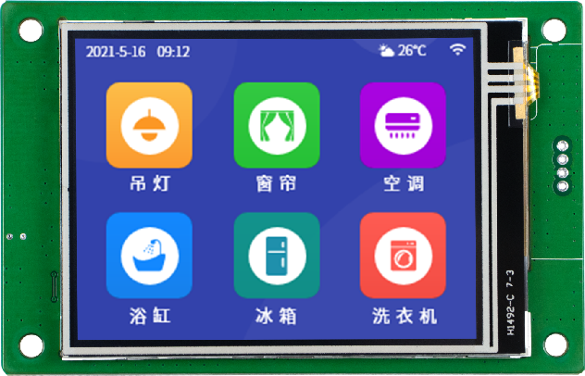
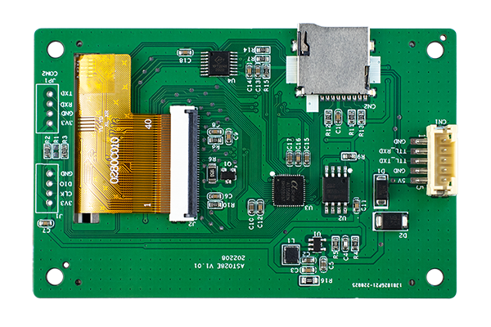
ASTE024 / ASTE028series
Model | ASTE024RTS/ASTE024NTS | ASTE028RTS/ASTE028NTS
display screen | 2.4" TFT LCD | 2.8" TFT LCD
color | 65535 colors | 65535 colors
Resolution (Px) | 320*240 | 320*240
brightness | 250 cd/m² | 250 cd/m²
Backlight | LED | LED
LED lifespan | 20,000 hours | 20,000 hours
touch screen | ASTE024RTS Support 4-wire industrial resistive touch screen (surface hardness 4H) | ASTE028RTS Support 4-wire industrial resistive touch screen (surface hardness 4H)
CPU | 96MHz M0 | 96MHz M0
memorizer | 4Mbyte SPI NOR Flash | 4Mbyte SPI NOR Flash
RTC | not | not
buzzer | not | not
Power-down data is saved | Not supported | Not supported
USB port | not | not
How to download the program | SD card download | SD card download
flash drive | Not supported | Not supported
Communication port | ASTE024RTS: One TTL serial port communication (with touch) ASTE024NTS: One TTL serial port communication (without touch) | ASTE028RTS: One TTL serial port communication (with touch) ASTE028NTS: One TTL serial port communication (without touch)
Rated power | 0.5W | 0.5W
Rated voltage | DC 5V(Anti-reverse connection is not supported) | DC 5V(Anti-reverse connection is not supported)
Operating temperature | -10℃~50℃ | -10℃~50℃
Storage temperature | -30℃~70℃ | -30℃~70℃

Slide 8
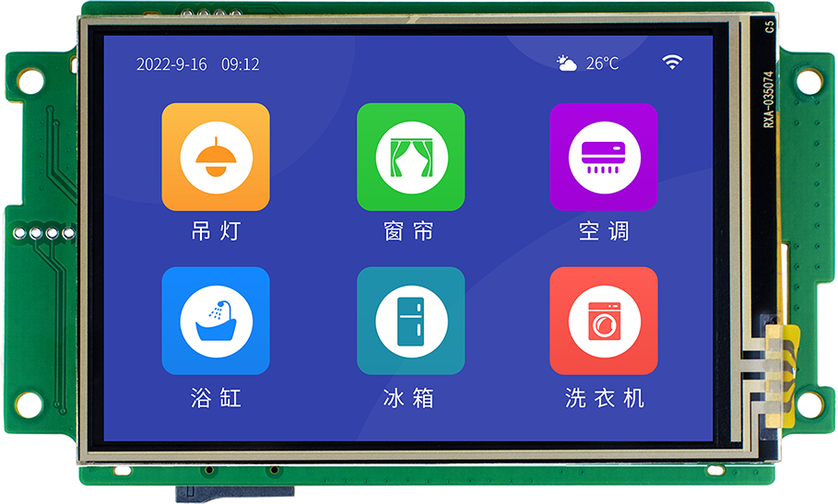
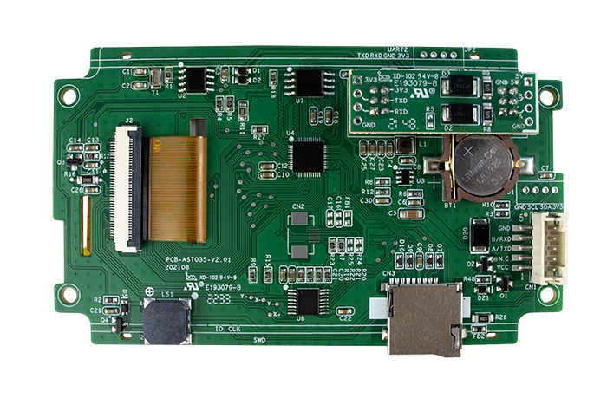
AST 035 系列
Model | AST035RDS/AST035RES/AST035RTS
display screen | 3.5" TFT LCD
color | 480*320
Resolution (Px) | 65535 colors
brightness | 250 cd/m²
Backlight | LED
LED lifespan | 20,000 hours
touch screen | 4-wire industrial resistive touch screen (surface hardness 4H)
CPU | 96MHz M0
memorizer | 16Mbyte SPI NOR Flash
RTC | Real-time clock built-in
buzzer | Yes
Power-down data is saved | Not supported
USB port | not
How to download the program | SD card download
flash drive | Not supported
Communication port | AST035RES (232 communication port) AST035RDS (485 communication port) AST035RTS (TTL communication port, TTL can only be powered by 5V)
Rated power | 0.6W
Voltage range | DC 5-24V(TTL communication port, TTL can only be powered by 5V)
Operating temperature | -10℃~50℃
Storage temperature | -30℃~70℃

Slide 9
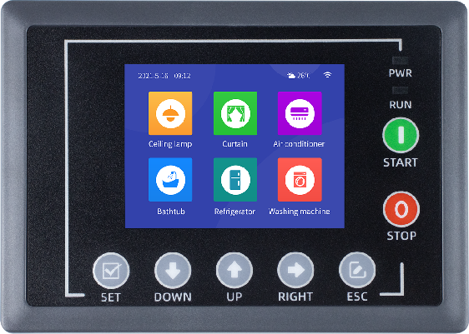
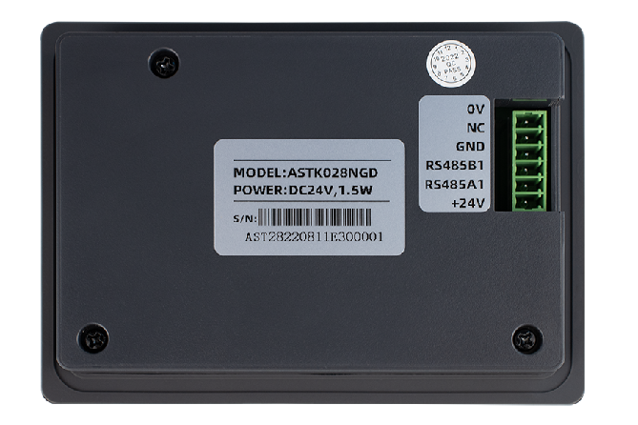
ASTK028NGD/ASTK028RGD
Model | ASTK028NGD/ASTK028RGD
display screen | 2.8" TFT LCD
color | 65535 colors
Resolution (Px) | 320*240
brightness | 250 cd/m²
Backlight | LED
LED lifespan | 20,000 hours
touch screen | ASTK028RGD Support 4-wire industrial resistive touch screen (surface hardness 4H)
CPU | 96MHz M0
memorizer | 16Mbyte SPI NOR Flash
RTC | Real-time clock built-in
buzzer | Yes
Power-down data is saved | Not supported
USB port | not
How to download the program | SD card download
flash drive | Not supported
Communication port | RS485 serial communication
Rated power | 1.5W
Voltage range | DC 12-24V(Anti-reverse connection, distinguish between positive and negative poles of power supply)
Operating temperature | -10℃~50℃
Storage temperature | -30℃~70℃

Slide 10
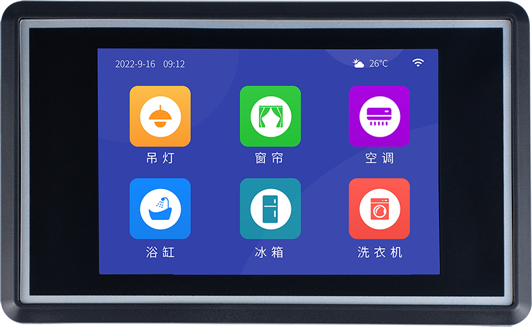
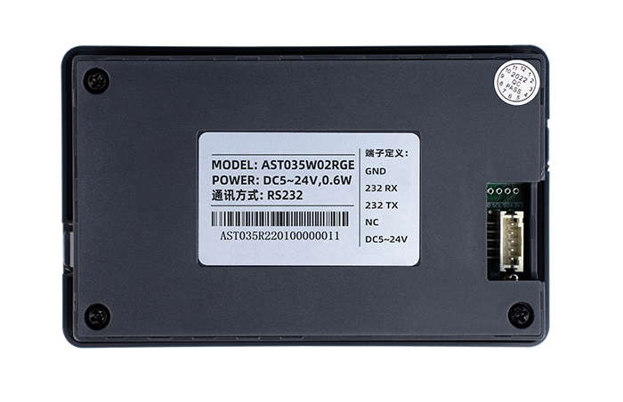
AST 035 W02R 系列
Model | AST035W02RGD/AST035W02RGE
display screen | 3.5" TFT LCD
color | 480*320
Resolution (Px) | 65535 colors
brightness | 250 cd/m²
Backlight | LED
LED lifespan | 20,000 hours
touch screen | 4-wire industrial resistive touch screen (surface hardness 4H)
CPU | 96MHz M0
memorizer | 16Mbyte SPI NOR Flash
RTC | Real-time clock built-in
buzzer | Yes
Power-down data is saved | Not supported
USB port | not
How to download the program | SD card download
flash drive | Not supported
Communication port | AST035RGE (232 communication port) AST035RGD (485 communication port)
Rated power | 0.6W
Voltage range | DC 5-24V
Operating temperature | -10℃~50℃
Storage temperature | -30℃~70℃

Slide 11
MGC series

Slide 12
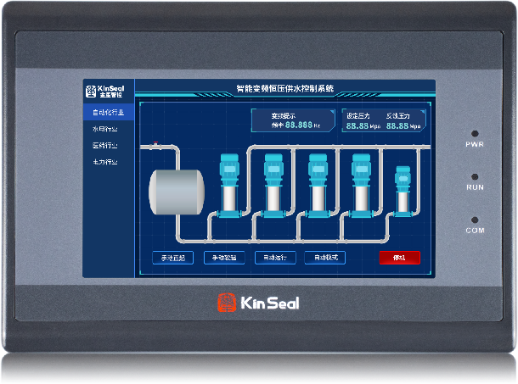
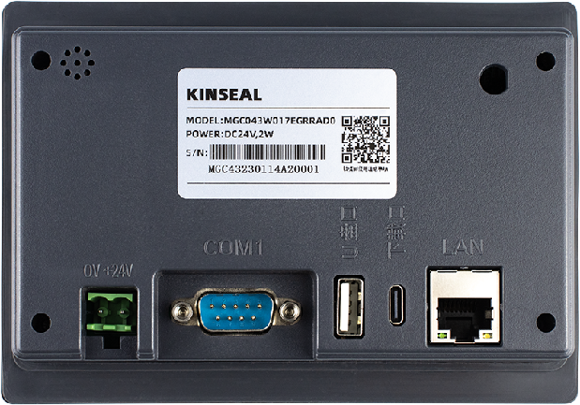
MGC 043 W01 7EGR series
Model | MGC043W017EGR
operating system | LINUX
display screen | 4.3" TFT LCD
Resolution (Px) | 480X272
color | 16.77 million colors
brightness | 300 cd/m²
Backlight | LED (Support backlight adjustment)
LED lifespan | 20,000 hours
touch screen | 4-wire industrial resistive touch screen (surface hardness 4H)
CPU | 64-bit 1GHz clock speed Built-in 64MB DDR memory
memorizer | 128Mbyte SPI Nand Flash
RTC | Real-time clock built-in
buzzer | Yes
Ethernet | Optional
4G Internet of Things | Optional (customized according to customer needs)
Audio playback | Optional (available on request)
I2C external keyboard | Optional (available on request)
Power-down data is saved | In the tank
USB port 1 | USB2.0 Device Port (TYPE-C USB Upgrade Port)
USB port 2 | USB2.0 HOST port (USB flash drive upgrade port)
How to download the program | USB, USB flash drive, Ethernet (only supported by Ethernet)
flash drive | In the tank
Communication port | Serial port 1: RS232/RS485/RS422
 | Serial port 2: RS485
Rated power | 2W
Voltage range | DC 19-30V
Power protection | It has the ability of +/-4KV lightning surge protection
Power loss is allowed | <5ms
CE&ROHS | Comply with EN61000-6-2:2005 and EN61000-6-4:2007 standards; Lightning surge +/-4KV, swarm pulse +/-4KV; Electrostatic contact discharge +/-5KV; Electrostatic air discharge +/-5KV.
Operating temperature | -10℃~50℃
Storage temperature | -30℃~70℃

Slide 13
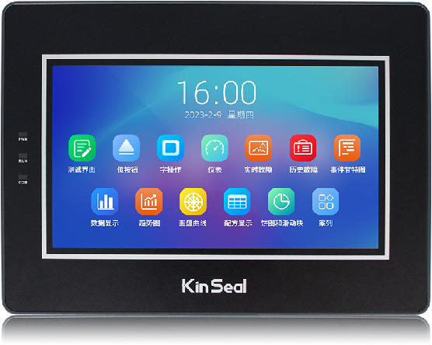
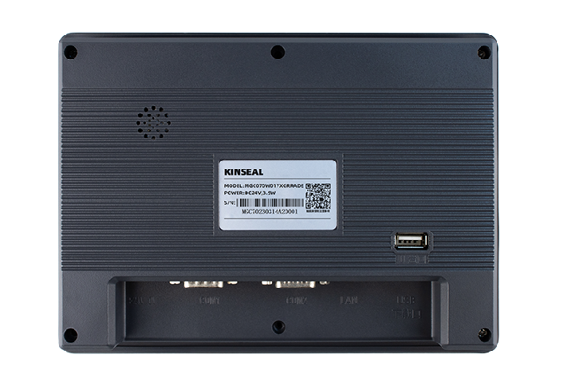
MGC 070 W01 7XGR series
Model | MGC070W017XGR
operating system | LINUX
display screen | 7" TFT LCD
Resolution (Px) | 800X480
color | 16.77 million colors
brightness | 400 cd/m²
Backlight | LED (Support backlight adjustment)
LED lifespan | 20,000 hours
touch screen | 4-wire industrial resistive touch screen (surface hardness 4H)
CPU | 64-bit1GHz built-in DDR memory
memorizer | 128Mbyte SPI Nand Flash
RTC | Real-time clock built-in
buzzer | Yes
Ethernet | Yes (optional)
4G Internet of Things | Supportable (customized according to customer needs)
Audio playback | Supportable (available on demand)
I2C external keyboard | Supportable (available on demand)
Power-down data is saved | In the tank
USB port 1 | USB2.0 Device port, (TYPE-CUSB upgrade port)
USB port 2 | USB2.0 HOST port, (USB flash drive upgrade port)
How to download the program | USB, USB flash drive, Ethernet (only supported by Ethernet)
flash drive | In the tank
Communication port | Serial port 1: RS232, RS485, RS422; Serial port 2: RS485; Serial port 3: RS232 (reserved)
Rated power | 3.5W max
Voltage range | DC 19-30V
Power protection | It has the ability of +/-4KV lightning surge protection
Power loss is allowed | <5ms
CE&ROHS | Comply with EN61000-6-2:2005 and EN61000-6-4:2007 standards; Lightning surge +/-4KV, swarm pulse +/-1.2KV; Electrostatic contact discharge +/-5KV; Electrostatic air discharge +/-5KV.
Operating temperature | -10℃~50℃
Storage temperature | -30℃~70℃

Slide 14
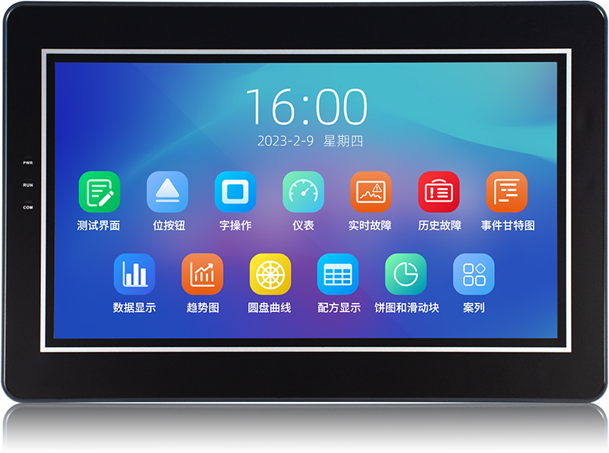
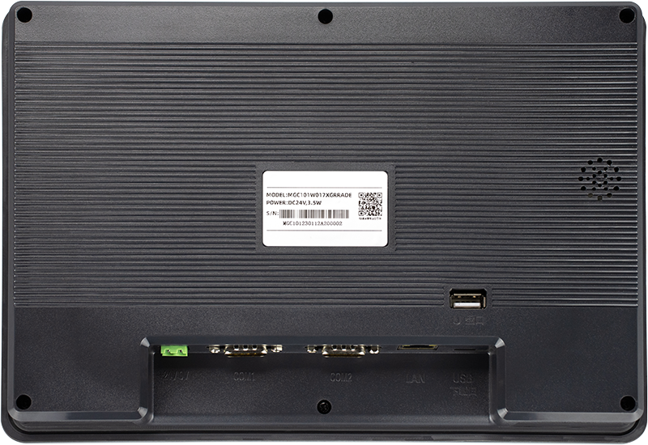
MGC 101 W01 7XGR series
Model | MGC101W017XGRRADE
operating system | LINUX
display screen | 10.1" TFT LCD
Resolution (Px) | 1024X600
color | 16.77 million colors
brightness | 250cd/m²
Backlight | LED (Support backlight adjustment)
LED lifespan | 20,000 hours
touch screen | 4-wire industrial resistive touch screen (surface hardness 4H)
CPU | 64-bit1GHz built-in DDR memory
memorizer | 128Mbyte SPI Nand Flash
RTC | Real-time clock built-in
buzzer | Yes
Ethernet | In the tank
4G Internet of Things | Supportable (customized according to customer needs)
Audio playback | Supportable (available on demand)
I2C external keyboard | Supportable (available on demand)
Power-down data is saved | In the tank
USB port 1 | USB2.0 Device Port (TYPE-CUSB Upgrade Port)
USB port 2 | USB2.0 HOST port (USB flash drive upgrade port)
How to download the program | USB, USB flash drive, Ethernet
flash drive | In the tank
Communication port | Serial port 1: RS232, RS485, RS422; Serial port 2: RS485; Serial port 3: RS232 (reserved)
Rated power | 3.5W max
Voltage range | DC 19-30V
Power protection | It has the ability of +/-4KV lightning surge protection
Power loss is allowed | <5ms
CE&ROHS | Comply with EN61000-6-2:2005 and EN61000-6-4:2007 standards; Lightning surge +/-4KV, swarm pulse +/-1.2KV; Electrostatic contact discharge +/-5KV; Electrostatic air discharge +/-5KV.
Operating temperature | -10℃~50℃
Storage temperature | -30℃~70℃

Slide 15
AMZ series

Slide 16
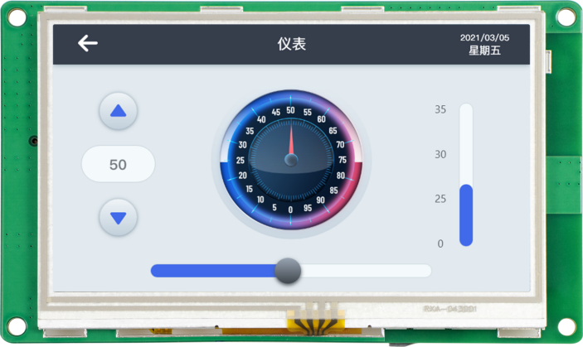
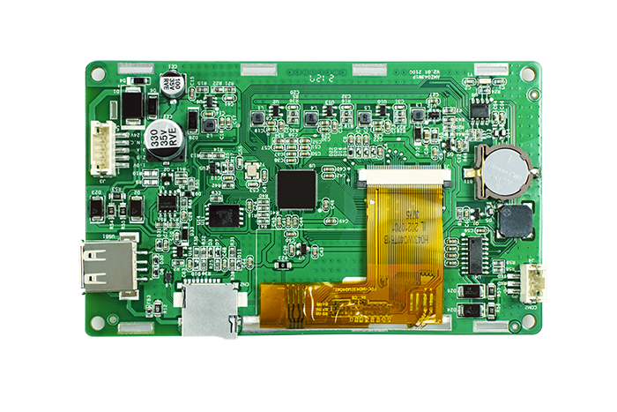
AMZ 043 W01 RDE
model | AMZ043W01RDE
display screen | 4.3" TFT LCD
Resolution (Px) | 480X272
colour | 260,000 colors
brightness | 300 cd/m²
Backlight | LED (supports backlight adjustment)
LED lifespan | 20,000 hours
Touch Screen | 4-wire industrial resistive touch screen (surface hardness 4H)
CPU | 32-bit 600MHz ARM9 built-in 32MB DDR memory
storage | 128Mbyte SPI Nand Flash
RTC | Real-time clock built-in
buzzer | Yes
Power-down data is saved | In the tank
USB port | 1 x USB 2.0 Device port
 | Note: Press and hold the screen to power on for 5 seconds, it will automatically enter the system parameter setting interface, and download it by selecting USB. Or download a USB flash drive to switch the download mode
How to download the program | USB, USB flash drive, SD card download
flash drive | Yes, the switching mode is set through the software system
Communication port | Serial port 1: RS485 Serial port 2: RS232
Rated power | 2W
Voltage range | DC10－30V
Power protection | It has the ability of +/-2KV lightning surge protection
Power loss is allowed | <5ms
CE&ROHS | Comply with EN61000-6-2:2005, EN61000-6-4:2007 standards, lightning surge +/-2KV, group pulse +/-4KV, electrostatic contact discharge +/-6KV, electrostatic air discharge +/-10KV.
Operating temperature | -10℃~50℃
Storage temperature | -30℃~70℃

Slide 17
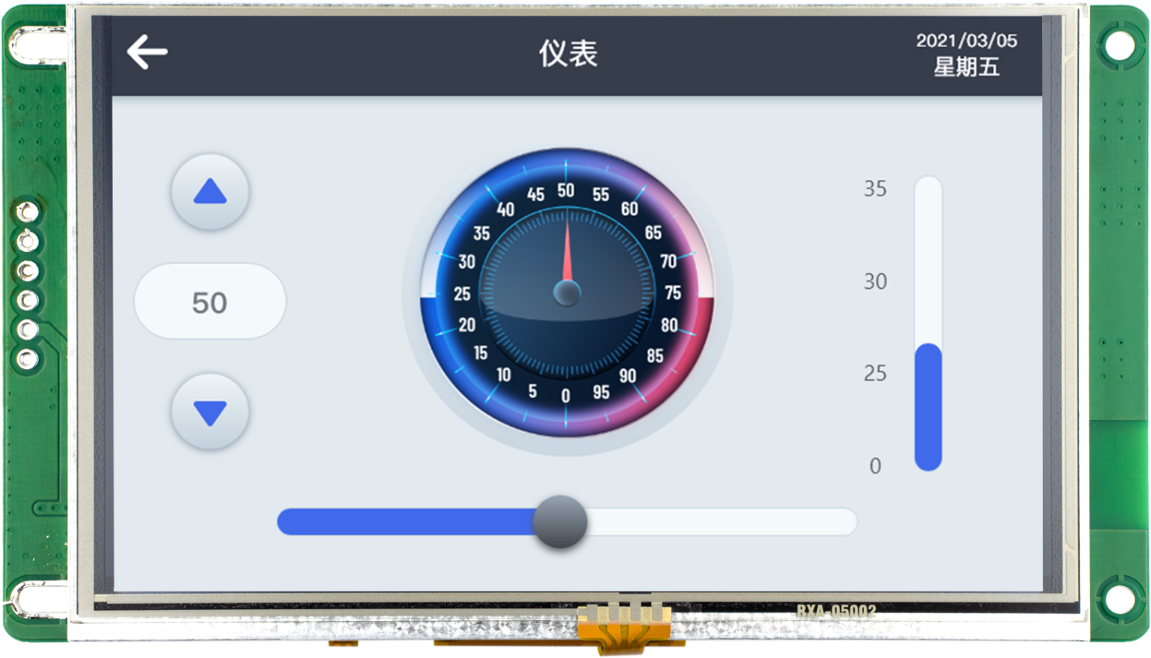
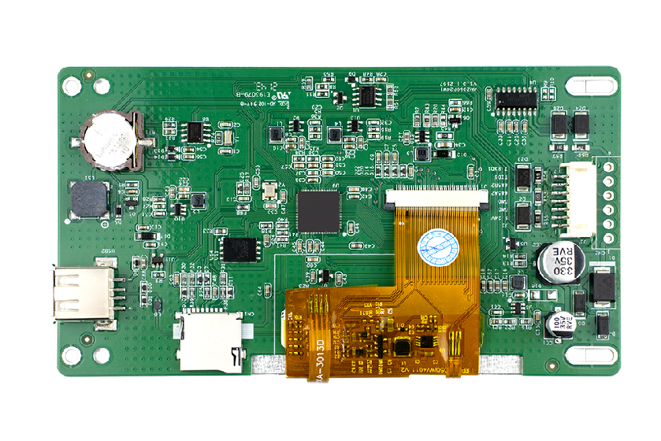
AMZ 050 W01 RED
model | AMZ050W01RED
display screen | 5" TFT LCD
Resolution (Px) | 800X480
color | 260,000 colors
brightness | 300 cd/m²
Backlight | LED (supports backlight adjustment)
LED lifespan | 20,000 hours
touch screen | 4-wire industrial resistive touch screen (surface hardness 4H), support capacitive touch screen
CPU | 32-bit 600MHz ARM9 has 32MB of DDR memory
memorizer | 128Mbyte SPI Nand Flash
RTC | Real-time clock built-in
Power-down data is saved | In the tank
buzzer | Yes
USB port | 1 x USB2.0 Device port, 1 x USB2.0 HOST port
 | Note: Press and hold the screen to power on for 5 seconds, it will automatically enter the system parameter setting interface, and download it by selecting USB. Or download a USB flash drive to switch the download mode
How to download the program | USB, USB flash drive, SD card download
flash drive | In the tank
Communication port | COM1：RS232
 | COM2：RS485
Rated power | 2W max
Voltage range | DC 10-30V
Power protection | It has the ability of +/-2KV lightning surge protection
Power loss is allowed | <5ms
CE&ROHS | Comply with EN61000-6-2:2005 and EN61000-6-4:2007 standards; Lightning surge +/-2KV, swarm pulse +/-4KV; Electrostatic contact discharge +/-6KV; Electrostatic air discharge +/-10KV.
Operating temperature | -10℃~50℃
Storage temperature | -30℃~70℃

Slide 18
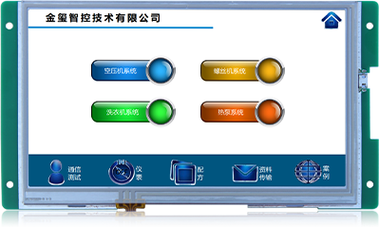
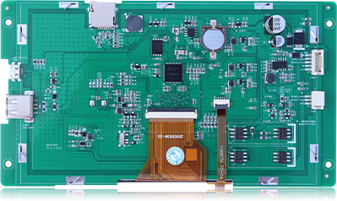
AMZ070P24
model | AMZ070P24
display screen | 7" TFT LCD
Resolution (Px) | 800X480
color | 260,000 colors
brightness | 400 cd/m²
Backlight | LED (supports backlight adjustment)
LED lifespan | 20,000 hours
touch screen | 4-wire industrial resistive touch screen (surface hardness 4H), capacitive touch screen can be customized
CPU | 32-bit 600MHz ARM9 built-in 32MB DDR memory
memorizer | 128Mbyte SPI Nand Flash
RTC | Real-time clock built-in
Power-down data is saved | In the tank
buzzer | Yes
USB port | 1 x USB2.0 Device port, 1 x USB2.0 HOST port
 | Note: Press and hold the screen to power on for 5 seconds, it will automatically enter the system parameter setting interface, and download it by selecting USB. Or download a USB flash drive to switch the download mode
How to download the program | USB, USB flash drive, SD card download
flash drive | In the tank
Communication port | Serial port 1: RS232, RS485 optional
 | Serial port 2: RS232, RS485 optional
Rated power | 3.5W
Voltage range | DC10-30V
Power protection | It has the ability of +/-2KV lightning surge protection
Power loss is allowed | <5ms
CE&ROHS | Comply with EN61000-6-2:2005 and EN61000-6-4:2007 standards; Lightning surge +/-2KV, swarm pulse +/-4KV; Electrostatic contact discharge +/-4KV; Electrostatic air discharge +/-8KV.
Operating temperature | -10℃~50℃
Storage temperature | -30℃~70℃

Slide 19
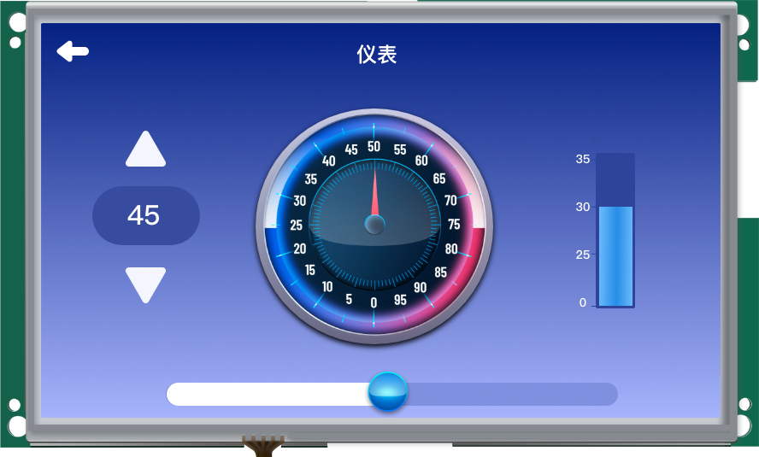

AMZ 101 P24
model | AMZ101P24
display screen | 10.1" TFT LCD
Resolution (Px) | 1024X600
color | 260,000 colors
brightness | 250 cd/m²
Backlight | LED (supports backlight adjustment)
LED lifespan | 20,000 hours
touch screen | 4-wire industrial resistive touch screen (surface hardness 4H), capacitive touch screen can be customized
CPU | 32-bit 600MHz ARM9 has 32MB of DDR memory
memorizer | 128Mbyte SPI Nand Flash
RTC | Real-time clock built-in
buzzer | Yes
Power-down data is saved | In the tank
USB port | 1 x USB2.0 Device port, 1 x USB2.0 HOST port
 | Note: Press and hold the screen to power on for 5 seconds, it will automatically enter the system parameter setting interface, and download it by selecting USB. Or download a USB flash drive to switch the download mode
How to download the program | USB, USB flash drive, SD card download
flash drive | In the tank
Communication port | Serial port 1: RS232, RS485, optional
 | Serial port 1: RS232, RS485, optional
Rated power | 3.5W
Voltage range | DC 10-30V
Power protection | It has the ability of +/-2KV lightning surge protection
允许失电 | <5ms
CE&ROHS | Comply with EN61000-6-2:2005 and EN61000-6-4:2007 standards; Lightning surge +/-2KV, swarm pulse +/-4KV; Electrostatic contact discharge +/-8KV; Electrostatic air discharge +/-10KV.
Operating temperature | -10℃~50℃
Storage temperature | -30℃~70℃

Slide 20


AMZ 035 W01 R series
Model | AMZ035W01RAWD/AMZ035W01RABD
display screen | 3.5" TFT LCD
Resolution (Px) | 320X240
color | 260,000 colors
brightness | 300 cd/m²
Backlight | LED (supports backlight adjustment)
LED lifespan | 20,000 hours
touch screen | 4-wire industrial resistive touch screen (surface hardness 4H)
CPU | 32-bit 600MHz ARM9
memorizer | 128Mbyte SPI Nand Flash
RTC | Real-time clock built-in
buzzer | Yes
Power-down data is saved | In the tank
USB port | 1个USB2.0 Device
How to download the program | USB download
flash drive | Not supported
Communication port | 2 serial ports, serial port 1: support RS232/RS485; Serial port 2: RS485
Rated power | <2W
Voltage range | DC 10-30V
Power protection | It has the ability of +/-2KV lightning surge protection
Power loss is allowed | <5ms
CE&ROHS | Comply with EN61000-6-2:2005, EN61000-6-4:2007 standards: lightning surge +/-2KV, group pulse +/-4KV; Electrostatic contact discharge +/-4KV; Electrostatic air discharge +/-10KV.
Operating temperature | -10℃~50℃
Storage temperature | -30℃~70℃

Slide 21


AMZ 043 W01 R series
Model | AMZ043W01R
display screen | 4.3" TFT LCD
Resolution (Px) | 480X272
color | 260,000 colors
brightness | 300 cd/m²
Backlight | LED
LED lifespan | 20,000 hours
touch screen | 4-wire industrial resistive touch screen (surface hardness 4H),
CPU | 32-bit 600MHz主频ARM9内置32MB DDR内存
memorizer | 128Mbyte SPI Nand Flash
RTC | Real-time clock built-in
buzzer | Yes
Power-down data is saved | In the tank
USB port | 1 x USB 2.0 Device port
How to download the program | USB, USB flash drive, SD card download
flash drive | In the tank
Communication port | Serial port 1: RS232, RS485, RS422 Serial port 2: RS232, RS485 optional
Rated power | ＜2W
Voltage range | DC 10-30V
Power protection | It has the ability of +/-2KV lightning surge protection
Power loss is allowed | <5ms
CE&ROHS | Comply with EN61000-6-2:2005 and EN61000-6-4:2007 standards; Lightning surge +/-2KV, swarm pulse +/-4KV; Electrostatic contact discharge +/-8KV; Electrostatic air discharge +/-10KV.
Operating temperature | -10℃~50℃
Storage temperature | -30℃~70℃

Slide 22

AMZ 043 W02 RDG
Model | AMZ043W02RDG
display screen | 4.3" TFT LCD
Resolution (Px) | 480X272
color | 260,000 colors
brightness | 300 cd/m²
Backlight | LED (supports backlight adjustment)
LED lifespan | 20,000 hours
touch screen | 4-wire industrial resistive touch screen (surface hardness 4H)
CPU | 32-bit 600MHz ARM9
memorizer | AMZ043W02RDG：16Mbyte SPI Nor Flash
RTC | Real-time clock built-in
buzzer | Yes
Power-down data is saved | AMZ043W02RDG: Not supported
USB port | 1 x USB 2.0 Device port Note: Press and hold the screen to power on for 5 seconds, it will automatically enter the system parameter setting interface, and download it by selecting USB. Or download a USB flash drive to switch the download mode
How to download the program | USB, SD card download
flash drive | Not supported
Communication port | Choose one of RS232, RS485, RS422
Rated power | ＜2W
Voltage range | DC 10-30V
Power protection | It has the ability of +/-2KV lightning surge protection
Power loss is allowed | <5ms
CE&ROHS | Comply with EN61000-6-2:2005 and EN61000-6-4:2007 standards; Lightning surge +/-2KV, swarm pulse +/-4KV; Electrostatic contact discharge +/-8KV; Electrostatic air discharge +/-10KV.
Operating temperature | -10℃~50℃
Storage temperature | -30℃~70℃

Slide 23


AMZ 043 W01 RPG series
Model | AMZ043W01RPGA
display screen | 4.3" TFT LCD
Resolution (Px) | 480X272
color | 260,000 colors
brightness | 300 cd/m²
Backlight | LED (supports backlight adjustment)
LED lifespan | 20,000 hours
touch screen | 4-wire industrial resistive touch screen (surface hardness 4H)
CPU | 32-bit 600MHz ARM9
memorizer | AMZ043W01RPGA：128Mbyte SPI NAND Flash
RTC | Real-time clock built-in
buzzer | Yes
Power-down data is saved | AMZ043W01RPGA: Yes
USB port | 1 x USB 2.0 Device port
How to download the program | USB, SD card download
flash drive | Not supported
Communication port | AMZ043W01RPGA: 1 serial port, serial port 1: support RS232/RS485
Rated power | ＜2W
Voltage range | DC 10-30V
Power protection | It has the ability of +/-2KV lightning surge protection
Power loss is allowed | <5ms
CE&ROHS | Comply with EN61000-6-2:2005 and EN61000-6-4:2007 standards; Lightning surge +/-2KV, swarm pulse +/-4KV; Electrostatic contact discharge +/-8KV; Electrostatic air discharge +/-10KV.
Operating temperature | -10℃~50℃
Storage temperature | -30℃~70℃

Slide 24


AMZ 043 W02 RPG series
Model | AMZ043W02RPGEG | AMZ043W02RDG
display screen | 4.3" TFT LCD | 4.3" TFT LCD
Resolution (Px) | 480X272 | 480X272
color | 260,000 colors | 260,000 colors
brightness | 300 cd/m² | 300 cd/m²
Backlight | LED (supports backlight adjustment) | LED (supports backlight adjustment)
LED lifespan | 20,000 hours | 20,000 hours
touch screen | 4-wire industrial resistive touch screen (surface hardness 4H) | 4-wire industrial resistive touch screen (surface hardness 4H)
CPU | 32-bit 600MHz ARM9 | 32-bit 600MHz ARM9
memorizer | 16Mbyte SPI Nor Flash | AMZ043W02RDG：16Mbyte SPI Nor Flash
RTC | In the tank | Real-time clock built-in
4G | In the tank | Not supported
buzzer | Yes | Yes
Power-down data is saved | Not supported | AMZ043W02RDG：Not supported
USB port | 1 x USB 2.0 Device port | 1 x USB 2.0 Device port Note: Press and hold the screen to power on for 5 seconds, it will automatically enter the system parameter setting interface, and download it by selecting USB. Or download a USB flash drive to switch the download mode
How to download the program | USB, SD card download | USB, SD card download
flash drive | Not supported | Not supported
Communication port | Serial port 1: RS232 | Choose one of RS232, RS485, RS422
Rated power | 2W | ＜2W
Voltage range | DC 10-30V | DC 10-30V
Power protection | It has the ability of +/-2KV lightning surge protection | It has the ability of +/-2KV lightning surge protection
Power loss is allowed | <5ms | <5ms
CE&ROHS | Comply with EN61000-6-2:2005 and EN61000-6-4:2007 standards; Lightning surge +/-2KV, swarm pulse +/-4KV; Electrostatic contact discharge +/-8KV; Electrostatic air discharge +/-10KV. | Comply with EN61000-6-2:2005 and EN61000-6-4:2007 standards; Lightning surge +/-2KV, swarm pulse +/-4KV; Electrostatic contact discharge +/-8KV; Electrostatic air discharge +/-10KV.
Operating temperature | -10℃~50℃ | -10℃~50℃
Storage temperature | -30℃~70℃ | -30℃~70℃

Slide 25


AMZ 070 W01 RXG series
Model | AMZ070W01RXGA/AMZ070W01RXGAD/AMZ070W01RXGAE
display screen | 7" TFT LCD
Resolution (Px) | 800X480
color | 260,000 colors
brightness | 400 cd/m²
Backlight | LED (supports backlight adjustment)
LED lifespan | 20,000 hours
touch screen | 4-wire industrial resistive touch screen (surface hardness 4H), capacitive touch screen can be customized
CPU | 32-bit 600MHz ARM9 built-in 32MB DDR memory
memorizer | 128Mbyte SPI Nand Flash
RTC | Real-time clock built-in
buzzer | Yes
Power-down data is saved | In the tank
USB port | 1 x USB2.0 Device port, 1 x USB2.0 HOST port
 | Note: Press and hold the screen to power on for 5 seconds, it will automatically enter the system parameter setting interface, and download it by selecting USB. Or download a USB flash drive to switch the download mode
How to download the program | USB, USB flash drive, SD card download
flash drive | In the tank
Communication port | Serial port 1: RS232, RS485, RS422 choose one
 | Serial port 2: RS232, RS485 can choose one of them
Rated power | 3.5W
Voltage range | DC 10-30V
Power protection | It has the ability of +/-2KV lightning surge protection
Power loss is allowed | <5ms
CE&ROHS | Comply with EN61000-6-2:2005 and EN61000-6-4:2007 standards; Lightning surge +/-2KV, swarm pulse +/-4KV; Electrostatic contact discharge +/-8KV; Electrostatic air discharge +/-15KV.
Operating temperature | -10℃~50℃
Storage temperature | -30℃~70℃

Slide 26


AMZ 043 W01/02 RLG series
Model | AMZ043W01RLGG | AMZ043W01RLG | AMZ043W02RLGG | AMZ043W02RLG
display screen | 4.3" TFT LCD | 4.3" TFT LCD | 4.3" TFT LCD | 4.3" TFT LCD
Resolution (Px) | 480X272 | 480X272 | 480X272 | 480X272
color | 260,000 colors | 260,000 colors | 260,000 colors | 260,000 colors
brightness | 300 cd/m² | 300 cd/m² | 300 cd/m² | 300 cd/m²
Backlight | LED (supports backlight adjustment) | LED (supports backlight adjustment) | LED (supports backlight adjustment) | LED (supports backlight adjustment)
LED lifespan | 20,000 hours | 20,000 hours | 20,000 hours | 20,000 hours
touch screen | 4-wire industrial resistive touch screen (surface hardness 4H) | 4-wire industrial resistive touch screen (surface hardness 4H) | 4-wire industrial resistive touch screen (surface hardness 4H) | 4-wire industrial resistive touch screen (surface hardness 4H)
CPU | 32-bit 600MHz ARM9 | 32-bit 600MHz ARM9 | 32-bit 600MHz ARM9 | 32-bit 600MHz ARM9
memorizer | 128Mbyte SPI Nand Flash | 128Mbyte SPI Nand Flash | 16Mbyte SPI Nor Flash | 16Mbyte SPI Nor Flash
RTC | In the tank | Real-time clock built-in | In the tank | Real-time clock built-in
4G | In the tank | Not supported | In the tank | Not supported
buzzer | Yes
Power-down data is saved | In the tank | In the tank | Not supported | Not supported
USB port | 1 x USB 2.0 Device port Note: Press and hold the screen to power on for 5 seconds, it will automatically enter the system parameter setting interface, and download it by selecting USB. Or download a USB flash drive to switch the download mode
How to download the program | USB, SD card download | USB, SD card | USB, SD card download | USB, SD card
flash drive | 不支持
Communication port | Serial port 1: RS485 | RS485 | Serial port 1: RS485 | RS485
Rated power | 2W | ＜2W | 2W | ＜2W
Voltage range | DC 10-30V
Power protection | It has the ability of +/-2KV lightning surge protection
Power loss is allowed | <5ms | <5ms | <5ms | <5ms
CE&ROHS | Comply with EN61000-6-2:2005 and EN61000-6-4:2007 standards; Lightning surge +/-2KV, swarm pulse +/-4KV; Electrostatic contact discharge +/-8KV; Electrostatic air discharge +/-10KV.
Operating temperature | -10℃~50℃
Storage temperature | -30℃~70℃

Slide 27


AMZ 043 W06 R series
Model | AMZ043W06RDD | AMZ043W06RDE
display screen | 4.3" TFT LCD | 4.3" TFT LCD
Resolution (Px) | 480X272 | 480X272
color | 260,000 colors | 260,000 colors
brightness | 300 cd/m² | 300 cd/m²
Backlight | LED (supports backlight adjustment) | LED (supports backlight adjustment)
LED lifespan | 20,000 hours | 20,000 hours
touch screen | 4-wire industrial resistive touch screen (surface hardness 4H) | 4-wire industrial resistive touch screen (surface hardness 4H)
CPU | 32-bit 600MHz ARM9 built-in 8MB DDR memory | 32-bit 600MHz ARM9 built-in 8MB DDR memory
memorizer | 16Mbyte SPI Nor Flash | 16Mbyte SPI Nor Flash
RTC | Real-time clock built-in | Real-time clock built-in
buzzer | Yes | Yes
Power-down data is saved | Not supported | Not supported
USB port | 1 x USB 2.0 Device port | 1 x USB 2.0 Device port
How to download the program | USB, SD card download | USB, SD card download
flash drive | Not supported | Not supported
Communication port | 1 serial port, serial port 1: support RS485 | 1 serial port, serial port 1: support RS232
Rated power | ＜2W | ＜2W
Voltage range | DC 10-30V | DC 10-30V
Power protection | It has the ability of +/-3KV lightning surge protection | It has the ability of +/-3KV lightning surge protection
Power loss is allowed | <5ms | <5ms
CE&ROHS | Comply with EN61000-6-2:2005 and EN61000-6-4:2007 standards; Lightning surge +/-3KV, swarm pulse +/-3KV; Electrostatic contact discharge +/-4KV; Electrostatic air discharge +/-4KV.
Operating temperature | -10℃~50℃ | -10℃~50℃
Storage temperature | -30℃~70℃ | -30℃~70℃

Slide 28


AMZ 043 W06 RPG series
Model | AMZ043W06RPGE | AMZ043W06RPGD
display screen | 4.3" TFT LCD | 4.3" TFT LCD
Resolution (Px) | 480X272 | 480X272
color | 260,000 colors | 260,000 colors
brightness | 300 cd/m² | 300 cd/m²
brightness | LED (supports backlight adjustment) | LED (supports backlight adjustment)
LED lifespan | 20,000 hours | 20,000 hours
touch screen | 4-wire industrial resistive touch screen (surface hardness 4H) | 4-wire industrial resistive touch screen (surface hardness 4H)
CPU | 32-bit 600MHz ARM9 built-in 8MB DDR memory | 32-bit 600MHz ARM9 built-in 8MB DDR memory
memorizer | 16Mbyte SPI Nor Flash | 16Mbyte SPI Nor Flash
RTC | Real-time clock built-in | Real-time clock built-in
buzzer | Yes | Yes
Power-down data is saved | Not supported | Not supported
USB port | 1 x USB 2.0 Device port | 1 x USB 2.0 Device port
How to download the program | USB, SD card download | USB, SD card download
flash drive | Not supported | Not supported
Communication port | 1 serial port, serial port 1: support RS232 | 1 serial port, serial port 1: support RS485
Rated power | ＜2W | ＜2W
Ratdebauer | DC 10-30V | DC 10-30V
Power protection | It has the ability of +/-3KV lightning surge protection | It has the ability of +/-3KV lightning surge protection
Power loss is allowed | <5ms | <5ms
CE&ROHS | Comply with EN61000-6-2:2005 and EN61000-6-4:2007 standards; Lightning surge +/-3KV, swarm pulse +/-3KV; Electrostatic contact discharge +/-4KV; Electrostatic air discharge +/-4KV.
Operating temperature | -10℃~50℃ | -10℃~50℃
Storage temperature | -30℃~70℃ | -30℃~70℃

Slide 29


AMZ 070 W01 R series
Model | AMZ070W01R
display screen | 7" TFT LCD
Resolution (Px) | 800X480
color | 260,000 colors
brightness | 400 cd/m²
brightness | LED (supports backlight adjustment)
LED lifespan | 20,000 hours
touch screen | 4-wire industrial resistive touch screen (surface hardness 4H), capacitive touch screen can be customized
CPU | 32-bit 600MHz ARM9 built-in 32MB DDR memory
memorizer | 128Mbyte SPI Nand Flash
RTC | Real-time clock built-in
buzzer | Yes
Power-down data is saved | In the tank
USB port | 1 x USB2.0 Device port, 1 x USB2.0 HOST port
 | Note: Press and hold the screen to power on for 5 seconds, it will automatically enter the system parameter setting interface, and download it by selecting USB. Or download a USB flash drive to switch the download mode
How to download the program | USB, USB flash drive, SD card download
flash drive | In the tank
Communication port | Serial port 1: RS232, RS485, RS422 choose one
 | Serial port 2: RS232, RS485 optional
Rated power | 3.5W
Voltage range | DC 10-30V
Power protection | It has the ability of +/-2KV lightning surge protection
Power loss is allowed | <5ms
CE&ROHS | Comply with EN61000-6-2:2005 and EN61000-6-4:2007 standards; Lightning surge +/-2KV, swarm pulse +/-4KV; Electrostatic contact discharge +/-8KV; Electrostatic air discharge +/-15KV.
Operating temperature | -10℃~50℃
Storage temperature | -30℃~70℃

Slide 30


AMZ 070 W01 RPDG series
Model | AMZ070W01RPDG/AMZ070W01RPDGD/AMZ070W01RPDGE | AMZ070W01RPDGG
display screen | 7" TFT LCD | 7" TFT LCD
Resolution (Px) | 800X480 | 800X480
color | 260,000 colors | 260,000 colors
brightness | 400 cd/m² | 400 cd/m²
brightness | LED (supports backlight adjustment) | LED (supports backlight adjustment)
LED lifespan | 20,000 hours | 20,000 hours
touch screen | 4-wire industrial resistive touch screen (surface hardness 4H), capacitive touch screen can be customized | 4-wire industrial resistive touch screen (surface hardness 4H), capacitive touch screen can be customized
CPU | 32-bit 600MHz ARM9 has 32MB of DDR memory | 32-bit 600MHz ARM9 has 32MB of DDR memory
memorizer | 128Mbyte | 128Mbyte SPI Nand Flash
RTC | In the tank | Real-time clock built-in
4G | Not supported | In the tank
buzzer | Yes | Yes
Power-down data is saved | In the tank | In the tank
USB port | 1 USB TYPE-A PORT, WHICH CAN BE SET TO USB/U DISK DOWNLOAD MODE THROUGH THE SYSTEM PARAMETER SETTING INTERFACE Note: Press and hold the screen to power on for 5 seconds, it will automatically enter the system parameter setting interface, and download it by selecting USB. Or download a USB flash drive to switch the download mode | 1 USB TYPE-A PORT, WHICH CAN BE SET TO USB/U DISK DOWNLOAD MODE THROUGH THE SYSTEM PARAMETER SETTING INTERFACE Note: Press and hold the screen to power on for 5 seconds, it will automatically enter the system parameter setting interface, and download it by selecting USB. Or download a USB flash drive to switch the download mode
How to download the program | USB, USB flash drive, SD card download | USB, USB flash drive, SD card download
flash drive | In the tank | In the tank
Communication port | AMZ070W01RPDG: Serial port 1: RS485; AMZ070W01RPDGD: Serial port 1: RS485; Serial port 2: RS485; AMZ070W01RPDGE: Serial port 1: RS485; Serial port 2: RS232; | Serial port 1: RS485
Rated power | 3.5W | 3.5W
Voltage range | DC 10-30V | DC 10-30V
The power supply is anti-reversed | In the tank
Power protection | It has the ability of +/-2KV lightning surge protection | It has the ability of +/-2KV lightning surge protection
Power loss is allowed | <5ms | <5ms
CE&ROHS | Comply with EN61000-6-2:2005 and EN61000-6-4:2007 standards; Lightning surge +/-2KV, swarm pulse +/-4KV; Electrostatic contact discharge +/-8KV; Electrostatic air discharge +/-15KV. | Comply with EN61000-6-2:2005 and EN61000-6-4:2007 standards; Lightning surge +/-2KV, swarm pulse +/-4KV; Electrostatic contact discharge +/-8KV; Electrostatic air discharge +/-15KV.
Operating temperature | -10℃~50℃ | -10℃~50℃
Storage temperature | -30℃~70℃ | -30℃~70℃

Slide 31


AMZ 070 W06 R series
Model | AMZ070W06REG | AMZ070W06RDG
display screen | 7" TFT LCD | 7" TFT LCD
Resolution (Px) | 800X480 | 800X480
color | 260,000 colors | 260,000 colors
brightness | 400 cd/m² | 400 cd/m²
brightness | LED (supports backlight adjustment) | LED (supports backlight adjustment)
LED lifespan | 20,000 hours | 20,000 hours
touch screen | 4-wire industrial resistive touch screen (surface hardness 4H) | 4-wire industrial resistive touch screen (surface hardness 4H)
CPU | 32-bit 600MHz ARM9 built-in 8MB DDR memory | 32-bit 600MHz ARM9 built-in 8MB DDR memory
memorizer | 16Mbyte SPI Nand Flash | 16Mbyte SPI Nand Flash
RTC | Real-time clock built-in | Real-time clock built-in
buzzer | Yes | Yes
Power-down data is saved | Not supported | Not supported
USB port | 1 x USB 2.0 Device port | 1 x USB 2.0 Device port
How to download the program | USB, SD card download | USB, SD card download
flash drive | Not supported | Not supported
Communication port | 1 serial port, serial port 1: support RS232 | 1 serial port, serial port 1: support RS485
Rated power | 3.5W max | 3.5W max
Voltage range | DC 10-30V | DC 10-30V
Power protection | It has the ability of +/-3KV lightning surge protection | It has the ability of +/-3KV lightning surge protection
Power loss is allowed | <5ms | <5ms
CE&ROHS | Comply with EN61000-6-2:2005 and EN61000-6-4:2007 standards; Lightning surge +/-3KV, swarm pulse +/-3KV; Electrostatic contact discharge +/-4KV; Electrostatic air discharge +/-4KV.
Operating temperature | -10℃~50℃ | -10℃~50℃
Storage temperature | -30℃~70℃ | -30℃~70℃

Slide 32


AMZ 070 W06 RPG series
Model | AMZ070W06RPGD | AMZ070W06RPGE
display screen | 7" TFT LCD | 7" TFT LCD
Resolution (Px) | 800X480 | 800X480
color | 260,000 colors | 260,000 colors
brightness | 400 cd/m² | 400 cd/m²
brightness | LED (supports backlight adjustment) | LED (supports backlight adjustment)
LED lifespan | 20,000 hours | 20,000 hours
touch screen | 4-wire industrial resistive touch screen (surface hardness 4H) | 4-wire industrial resistive touch screen (surface hardness 4H)
CPU | 32-bit 600MHz ARM9 built-in 8MB DDR memory | 32-bit 600MHz ARM9 built-in 8MB DDR memory
memorizer | 16Mbyte SPI Nand Flash | 16Mbyte SPI Nand Flash
RTC | Real-time clock built-in | Real-time clock built-in
buzzer | Yes | Yes
Power-down data is saved | In the tank | In the tank
USB port | 1 x USB 2.0 Device port | 1 x USB 2.0 Device port
How to download the program | USB, SD card download | USB, SD card download
flash drive | Not supported | Not supported
Communication port | 1 serial port, serial port 1: support RS485 | 1 serial port, serial port 1: support RS232
Rated power | 3.5W | 3.5W
Voltage range | DC 10-30V | DC 10-30V
Power protection | It has the ability of +/-3KV lightning surge protection | It has the ability of +/-3KV lightning surge protection
Power loss is allowed | <5ms | <5ms
CE&ROHS | Comply with EN61000-6-2:2005 and EN61000-6-4:2007 standards; Lightning surge +/-3KV, swarm pulse +/-3KV; Electrostatic contact discharge +/-4KV; Electrostatic air discharge +/-4KV.
Operating temperature | -10℃~50℃ | -10℃~50℃
Storage temperature | -30℃~70℃ | -30℃~70℃

Slide 33


AMZ 101 W01 RAG series
Model | AMZ101W01RAG/AMZ101W01RAGD/AMZ101W01RAGE
display screen | 10.1" TFT LCD
Resolution (Px) | 1024X600
color | 260,000 colors
brightness | 400 cd/m²
brightness | LED (supports backlight adjustment)
LED lifespan | 20,000 hours
touch screen | 4-wire industrial resistive touch screen (surface hardness 4H), capacitive touch screen can be customized
CPU | 32-bit 600MHz ARM9 built-in 32MB DDR memory
memorizer | 128Mbyte SPI Nand Flash
RTC | Real-time clock built-in
buzzer | Yes
Power-down data is saved | In the tank
USB1 | TYPE-C type, download port
USB2 | TYPE-A, download port
How to download the program | USB, USB flash drive, SD card download
flash drive | In the tank
 | Note: Press and hold the screen to power on for 5 seconds, it will automatically enter the system parameter setting interface, and download it by selecting USB. Or download a USB flash drive to switch the download mode
Communication port | Serial port 1: RS232, RS485, RS422 choose one
 | Serial port 2: RS232, RS485d only supports one of them
Rated power | 3.5W
Voltage range | DC 10-30V
Power protection | It has the ability of +/-2KV lightning surge protection
Power loss is allowed | <5ms
CE&ROHS | Comply with EN61000-6-2:2005 and EN61000-6-4:2007 standards; Lightning surge +/-2KV, swarm pulse +/-4KV; Electrostatic contact discharge +/-8KV; Electrostatic air discharge +/-15KV.
Operating temperature | -10℃~50℃
Storage temperature | -30℃~70℃

Slide 34
AMTseries

Slide 35


MT043W016-L480X272R series
Model | AMT043W016-L480X272R-X1
operating system | UCOS
display screen | 4.3" TFT LCD
Resolution (Px) | 480X272
color | 65536
brightness | 250 cd/m²
Backlight | LED (supports backlight adjustment)
LED life | 20,000 hours
touch screen | 4-wire industrial resistive touch screen (surface hardness 4H)
CPU | The 600MHz ARM9 has 32MB of DDR2 memory
memorizer | 64Mbyte SPI NANDFlash
RTC | In the tank
buzzer | In the tank
Power-down data is saved | Yes, 3S auto-save
USB port | not
How to download the program | SD card
Communication port | 1 serial port, RS232 or RS485 optional
Rated power | 2W max
Rated voltage | DC9-30V
Power protection | It has the ability of +/-1KV lightning surge protection
Power loss is allowed | <5ms
CE&ROHS | Comply with EN61000-6-2:2005 and EN61000-6-4:2007 standards; Lightning surge +/-1KV, swarm pulse +/-4KV; Electrostatic contact discharge +/-4KV; Electrostatic air discharge +/-8KV.
Operating temperature | -10℃~50℃
Storage temperature | -30℃~70℃

Slide 36

AMT043W124-L480X272R series
Model | AMT043W124-L480X272R-X1
operating system | UCOS
display screen | 4.3" TFT LCD
Resolution (Px) | 480X272
color | 65536
brightness | 250 cd/m²
Backlight | LED (supports backlight adjustment)
LED life | 20,000 hours
touch screen | 4-wire industrial resistive touch screen (surface hardness 4H)
CPU | The 600MHz ARM9 has 8MB of DDR2 memory
memorizer | 16Mbyte SPI NORFlash
RTC | In the tank
buzzer | In the tank
Power-down data is saved | Yes, 3S auto-save
USB port | not
How to download the program | SD card
Communication port | 1 serial port, RS232 or RS485 optional
Rated power | 2W max
Rated voltage | DC9-30V
Power protection | +/-250V lightning surge protection
Power loss is allowed | <5ms
CE&ROHS | Comply with EN61000-6-2:2005 and EN61000-6-4:2007 standards; Lightning surge +/-250V, swarm pulse +/-2KV; Electrostatic contact discharge +/-4KV; Electrostatic air discharge +/-8KV.
Operating temperature | -10℃~50℃
Storage temperature | -30℃~70℃

Slide 37


AMT070W016-L800X4800R-X1series
Model | AMT070W016-L800X480R-X1
operating system | UCOS
display screen | 7" TFT LCD
Resolution (Px) | 800X480
color | 65536
brightness | 250 cd/m²
Backlight | LED (supports backlight adjustment)
LED life | 20,000 hours
touch screen | 4-wire industrial resistive touch screen (surface hardness 4H)
CPU | The 600MHz ARM9 has 32MB of DDR2 memory
memorizer | 64Mbyte SPI NANDFlash
RTC | Optional
buzzer | In the tank
Power-down data is saved | Yes, 3S auto-save
USB port | not
How to download the program | SD card
Communication port | 1 serial port, RS232 or RS485 optional
Rated power | 3.5W max
Rated voltage | DC9-30V
Power protection | It has the ability of +/-1KV lightning surge protection
Power loss is allowed | <5ms
CE&ROHS | Comply with EN61000-6-2:2005, EN61000-6-4:2007 standards, lightning surge +/-1KV, group pulse +/-4KV, electrostatic contact discharge +/-4KV, electrostatic air discharge +/-8KV.
Operating temperature | -10℃~50℃
Storage temperature | -30℃~70℃

Slide 38

AMT070W124-L800X480R-X series
Model | AMT070W124-L800X480R-X1
operating system | UCOS
display screen | 7" TFT LCD
Resolution (Px) | 800X480
color | 65536
brightness | 250 cd/m²
Backlight | LED (supports backlight adjustment)
LED life | 20,000 hours
touch screen | 4-wire industrial resistive touch screen (surface hardness 4H)
CPU | 600MHz ARM9 built-in 8MB DDR2 memory
memorizer | 16Mbyte SPI NOR Flash
RTC | Optional
buzzer | In the tank
Power-down data is saved | Yes, 3S auto-save
USB port | not
How to download the program | SD card
Communication port | 1 serial port, RS232 or RS485 optional
Rated power | 3.5W max
Rated voltage | DC9-30V
Power protection | +/-250V lightning surge protection
Power loss is allowed | <5ms
CE&ROHS | Comply with EN61000-6-2:2005 and EN61000-6-4:2007 standards; Lightning surge +/-250V, swarm pulse +/-2KV; Electrostatic contact discharge +/-4KV; Electrostatic air discharge +/-8KV.
Operating temperature | -10℃~50℃
Storage temperature | -30℃~70℃

Slide 39


AMT043W024-L480X272C-1DEC
Model | AMT043W024-L480X272C-1DEC
operating system | UCOS
display screen | 4.3" TFT LCD
Resolution (Px) | 480X272
color | 65536
brightness | 250 cd/m²
Backlight | LED (supports backlight adjustment)
LED life | 20,000 hours
touch screen | Capacitive touch screen
CPU | The 600MHz ARM9 has 32MB of DDR2 memory
memorizer | 16Mbyte SPI NORFlash
RTC | In the tank
buzzer | In the tank
Power-down data is saved | In the tank
USB port | not
How to download the program | SD card
Communication port | Serial port 1: RS485
 | Serial port 2: RS232
Rated power | 2W max
Rated voltage | DC9-30V
Power protection | It has the ability of +/-1KV lightning surge protection
Power loss is allowed | <5ms
CE&ROHS | Comply with EN61000-6-2:2005 and EN61000-6-4:2007 standards; Lightning surge +/-1KV, swarm pulse +/-4KV; Electrostatic contact discharge +/-8KV; Electrostatic air discharge +/-8KV.
Operating temperature | -10℃~50℃

Slide 40

AMT043W024-L480X272C-0TT
Model | AMT043W024-L480X272C-0TT
operating system | UCOS
display screen | 4.3" TFT LCD
Resolution (Px) | 480X272
color | 65536
brightness | 250 cd/m²
Backlight | LED (supports backlight adjustment)
LED life | 20,000 hours
touch screen | Capacitive touch screen
CPU | The 600MHz ARM9 has 32MB of DDR2 memory
memorizer | 16Mbyte SPI NORFlash
RTC | Not supported
buzzer | In the tank
Power-down data is saved | In the tank
USB port | not
How to download the program | SD card
Communication port | Serial port 1: TTL
 | Serial port 2: TTL
Rated power | 2W max
Rated voltage | DC 5V
Power protection | It has the ability of +/-1KV lightning surge protection
Power loss is allowed | <5ms
CE&ROHS | Comply with EN61000-6-2:2005, EN61000-6-4:2007 standards, lightning surge +/-1KV, group pulse +/-4KV, electrostatic contact discharge +/-8KV, electrostatic air discharge +/-8KV.
Operating temperature | -10℃~50℃
Storage temperature | -30℃~70℃

Slide 41


AMT043W024-L480X272R-1DEC
Model | AMT043W024-L480X272R-1DEC
operating system | UCOS
display screen | 4.3" TFT LCD
Resolution (Px) | 480X272
color | 65536
brightness | 250 cd/m²
Backlight | LED (supports backlight adjustment)
LED life | 20,000 hours
touch screen | Resistive touch screen
CPU | The 600MHz ARM9 has 32MB of DDR2 memory
memorizer | 16Mbyte SPI NORFlash
RTC | In the tank
buzzer | In the tank
Power-down data is saved | In the tank
USB port | not
How to download the program | SD card
Communication port | Serial port 1: RS485
 | Serial port 2: RS232
Rated power | 2W max
Rated voltage | DC9-30V
Power protection | It has the ability of +/-1KV lightning surge protection
Power loss is allowed | <5ms
CE&ROHS | Comply with EN61000-6-2:2005 and EN61000-6-4:2007 standards; Lightning surge +/-1KV, swarm pulse +/-4KV; Electrostatic contact discharge +/-8KV; Electrostatic air discharge +/-8KV.
Operating temperature | -10℃~50℃
Storage temperature | -30℃~70℃

Slide 42


AMT043W024-L480X272R-0TT
Model | AMT043W024-L480X272R-0TT
operating system | UCOS
display screen | 4.3" TFT LCD
Resolution (Px) | 480X272
color | 65536
brightness | 250 cd/m²
Backlight | LED (supports backlight adjustment)
LED life | 20,000 hours
touch screen | 4-wire industrial resistive touch screen (surface hardness 4H)
CPU | The 600MHz ARM9 has 32MB of DDR2 memory
memorizer | 16Mbyte SPI NORFlash
RTC | Not supported
buzzer | In the tank
Power-down data is saved | In the tank
USB port | not
How to download the program | SD card
Communication port | Serial port 1: TTL
 | Serial port 2: TTL
Rated power | 2W max
Rated voltage | DC 5V
Power protection | It has the ability of +/-1KV lightning surge protection
Power loss is allowed | <5ms
CE&ROHS | Comply with EN61000-6-2:2005 and EN61000-6-4:2007 standards; Lightning surge +/-1KV, swarm pulse +/-4KV; Electrostatic contact discharge +/-8KV; Electrostatic air discharge +/-8KV.
Operating temperature | -10℃~50℃
Storage temperature | -30℃~70℃

Slide 43


AMT070W016-L800X480C-0TT
Model | AMT070W016-L800X480C-0TT
operating system | UCOS
display screen | 7" TFT LCD
Resolution (Px) | 800X480
color | 65536
brightness | 250 cd/m²
Backlight | LED (supports backlight adjustment)
LED life | 20,000 hours
touch screen | Capacitive touch screen
CPU | The 600MHz ARM9 has 32MB of DDR2 memory
memorizer | 64Mbyte SPI NANDFlash
RTC | Not supported
buzzer | In the tank
Power-down data is saved | In the tank
USB port | not
How to download the program | SD card
Communication port | Serial port 1: TTL
 | Serial port 2: TTL
Rated power | 3.5W max
Rated voltage | DC 5V
Power protection | It has the ability of +/-1KV lightning surge protection
Power loss is allowed | <5ms
CE&ROHS | Comply with EN61000-6-2:2005 and EN61000-6-4:2007 standards; Lightning surge +/-1KV, swarm pulse +/-4KV; Electrostatic contact discharge +/-8KV; Electrostatic air discharge +/-8KV.
Operating temperature | -10℃~50℃
Storage temperature | -30℃~70℃

Slide 44


AMT070W016-L800X480R-1DDC
Model | AMT070W016-L800X480R-1DDC
operating system | UCOS
display screen | 7" TFT LCD
Resolution (Px) | 800X480
color | 65536
brightness | 250 cd/m²
Backlight | LED (supports backlight adjustment)
LED life | 20,000 hours
touch screen | 4-wire industrial resistive touch screen (surface hardness 4H)
CPU | The 600MHz ARM9 has 32MB of DDR2 memory
memorizer | 64Mbyte SPI NANDFlash
RTC | In the tank
buzzer | In the tank
Power-down data is saved | In the tank
USB port | not
How to download the program | SD card
Communication port | Serial port 1: RS485
 | Serial port 2: RS485
Rated power | 3.5W max
Rated voltage | DC9-30V
Power protection | It has the ability of +/-1KV lightning surge protection
Power loss is allowed | <5ms
CE&ROHS | Comply with EN61000-6-2:2005 and EN61000-6-4:2007 standards; Lightning surge +/-1KV, swarm pulse +/-4KV; Electrostatic contact discharge +/-8KV; Electrostatic air discharge +/-8KV.
Operating temperature | -10℃~50℃
Storage temperature | -30℃~70℃

Slide 45


AMT070W016-L800X480R-0TT
Model | AMT070W016-L800X480R-0TT
operating system | UCOS
display screen | 7" TFT LCD
Resolution (Px) | 800X480
color | 65536
brightness | 250 cd/m²
Backlight | LED (supports backlight adjustment)
LED life | 20,000 hours
touch screen | 4-wire industrial resistive touch screen (surface hardness 4H)
CPU | The 600MHz ARM9 has 32MB of DDR2 memory
memorizer | 64Mbyte SPI NANDFlash
RTC | Not supported
buzzer | In the tank
Power-down data is saved | In the tank
USB端口 | not
How to download the program | SD card
Communication port | Serial port 1: TTL
 | Serial port 2: TTL
Rated power | 3.5W max
Rated voltage | DC 5V
Power protection | It has the ability of +/-1KV lightning surge protection
Power loss is allowed | <5ms
CE&ROHS | Comply with EN61000-6-2:2005 and EN61000-6-4:2007 standards; Lightning surge +/-1KV, swarm pulse +/-4KV; Electrostatic contact discharge +/-8KV; Electrostatic air discharge +/-8KV.
Operating temperature | -10℃~50℃
Storage temperature | -30℃~70℃

Slide 46

AMT070W016-L800X480R-1EEC
Model | AMT070W016-L800X480R-1EEC
operating system | UCOS
display screen | 7" TFT LCD
Resolution (Px) | 800X480
color | 65536
brightness | 250 cd/m²
Backlight | LED (supports backlight adjustment)
LED life | 20,000 hours
touch screen | 4-wire industrial resistive touch screen (surface hardness 4H)
CPU | The 600MHz ARM9 has 32MB of DDR2 memory
memorizer | 64Mbyte SPI NANDFlash
RTC | In the tank
buzzer | In the tank
Power-down data is saved | In the tank
USB port | not
How to download the program | SD card
Communication port | Serial port 1: RS232
 | Serial port 2: RS232
Rated power | 3.5W max
Rated voltage | DC9-30V
Power protection | It has the ability of +/-1KV lightning surge protection
Power loss is allowed | <5ms
CE&ROHS | Comply with EN61000-6-2:2005 and EN61000-6-4:2007 standards; Lightning surge +/-1KV, swarm pulse +/-4KV; Electrostatic contact discharge +/-8KV; Electrostatic air discharge +/-8KV.
Operating temperature | -10℃~50℃
Storage temperature | -30℃~70℃

Slide 47
Thanks for watching

